Slide 1
Cloud Computing
28 hours course
Notes:
Good morning everyone, and welcome to this 28-hour Cloud Computing course. My name is [Your Name], and I'll be your instructor throughout this journey. Over the next sessions, we're going to explore everything you need to know about cloud computing, from the fundamentals all the way to hands-on deployment of real applications on Google Cloud Platform. This course is designed to be practical and interactive, so don't hesitate to ask questions at any time. Let's get started!

Slide 2
TABLE OF CONTENTS
Introduction
The Information System of a Company
The Cloud
The Advantage of the Cloud (Cloud vs On-Premises)
Overview of Google Cloud Platform
Introduction to Operating Systems
  Linux vs Windows
  Linux / Windows Commands
Virtualization
Evolution of Application Deployment
Demo: Deployment of an ML Application
  Deployment on a Local Server (or VM) vs on GCP
    This step includes the installation and configuration of a VM from scratch
  Deployment in a Container Locally vs on a Managed Service on GCP
  Deployment of a Google Cloud Function
Main GCP Services
AI Services on GCP
Notes:
Here is a quick overview of everything we'll be covering in this course. We'll start with the basics — understanding what an Information System is and what Cloud Computing actually means. Then we'll compare Cloud versus On-Premises infrastructure. After that, we'll dive into Google Cloud Platform, operating systems, Linux commands, virtualization, and containers. The second half of the course is more hands-on: we'll deploy a real machine learning application step by step, from a local VM all the way to a fully managed serverless service on GCP. We'll close with an overview of major GCP services and AI capabilities on the platform. A lot to cover — let's make the most of it!

Slide 3
INTRODUCTION
Notes:
Let's begin with the Introduction section. Before we jump into technical content, I'd like to take a few minutes to get to know each other and understand your current level and expectations.

Slide 4
INTRODUCTION
Roundtable:
  Name, internship, missions and feedback
  Your knowledge in IT in general (cloud, infrastructure, etc.)
Presentation of an enterprise's IT infrastructure: on-premises vs. Cloud
How to deploy a machine learning application
Manipulation of cloud resources to better illustrate different concepts
Application of acquired knowledge
The more we interact, the more we learn, so take advantage of it!
Notes:
Let's start with a quick roundtable. I'd like each of you to introduce yourself — tell us your name, where you're currently doing your internship, what your main missions are, and how it's going so far. Also tell us a bit about your current knowledge in IT in general: have you ever worked with cloud infrastructure, set up a server, or deployed an application? This course will cover both theoretical concepts and practical hands-on work. The more you engage and interact, the more value you'll get out of it. So please, ask questions freely — there are no wrong questions here!

Slide 5
In your opinion, what is information system ?
What is cloud computing ?
Notes:
Before I give you any definitions, I'd like to hear from you first. In your opinion, what is an Information System? And what is Cloud Computing? Take a moment to think about it, and share your ideas. This is a great way to start from what you already know and build on it together.

Slide 6
THE INFORMATION SYSTEM OF A COMPANY
Notes:
Let's now move into our first major topic: The Information System of a Company. Understanding this is essential before we talk about the Cloud, because the Cloud is fundamentally a way to host and manage an Information System differently.

Slide 7
THE INFORMATION SYSTEM OF A COMPANY
The information system is an organized set of hardware, software, human, and procedural resources used to collect, store, process, and distribute information within a company.
It ensures the management and circulation of data necessary for the operation and decision-making within the company.
Well-designed architecture ensures the efficiency, security, and flexibility of the system, aligned with the company's objectives and needs.
Notes:
So, what exactly is an Information System? An Information System — or IS — is an organized set of hardware, software, human resources, and processes that work together to collect, store, process, and distribute information within a company. Think of it as the backbone of any organization. It ensures that data flows correctly between departments and that decision-makers have access to the right information at the right time. Well-designed IS architecture is efficient, secure, and flexible enough to evolve with the company's needs.

Slide 8
INFORMATION SYSTEM
Presentation of Main Components:
Servers:
  Computer hardware where applications and data are hosted. They handle the processing of various requests.
Network:
  Infrastructure enabling communication and data transmission between different system components.
Databases:
  Data management systems allowing storage, security, and access to information.
Application Software:
  Programs used to perform specific tasks within the company. This addresses business needs.
These components are physically located in a data center managed by the company or in a portion of a data center leased by the company.
Notes:
Let's break down the main components of an Information System. First, we have Servers — these are the physical or virtual machines that host applications and handle data processing. Then there's the Network — the infrastructure that connects all the components and allows data to travel between them. Next are Databases — these are systems dedicated to storing, organizing, and securing data. And finally, Application Software — programs designed to fulfill specific business functions, like an ERP, a CRM, or a custom internal tool. Traditionally, all of these components are physically located in a data center — either owned by the company, or in a shared data center where the company rents space.

Slide 9
Cloud Computing
Notes:
Now that we understand what an Information System is, let's talk about Cloud Computing — which is essentially a new way of hosting and delivering that same Information System, but through the Internet instead of physical infrastructure on-site.

Slide 10
CLOUD COMPUTING
Definition of Cloud Computing:
  A model for delivering computing resources over the Internet, allowing access to services on demand.
  Offers the same components of the IS infrastructure presented in the previous slides.
Explanation of How it Works:
  Data and applications are hosted on remote servers located in data centers managed by Cloud service providers.
  Users access resources on demand via the Internet, based on their needs.
Key Advantages:
  Scalability:
    Quickly adjust resources according to demand. For example, if there are too many requests on a website, launch multiple instances of the same virtual machine hosting it.
  Flexibility:
    Choice of services and features according to the specific needs of the company.
  Cost Reduction:
    Pay-as-you-go, avoiding significant initial investments. Start with basic usage and scale up as needed.
Notes:
Cloud Computing is a model for delivering computing resources — like servers, storage, databases, and software — over the Internet, on demand. Instead of owning and maintaining physical hardware, companies simply access these resources as a service and pay for what they use. Cloud Computing offers the same components as a traditional IS — servers, networking, databases, software — but they are managed remotely by a cloud provider. The key advantages are scalability — you can instantly increase or decrease resources based on demand; flexibility — you choose exactly what you need; and cost reduction — you pay only for what you consume, with no large upfront investments.

Slide 11
CLOUD COMPUTING
Presentation of Major Cloud Service Providers:
  Amazon Web Services (AWS):
    Offers a wide range of cloud services.
  Microsoft Azure:
    Strong integration with Microsoft products.
  Google Cloud Platform (GCP):
    Focuses on artificial intelligence and data analytics.
Brief Overview of Their Offerings and Market Share:
  All these providers offer virtually the same services.
  Each provider offers a diverse range of services tailored to the needs of businesses of all sizes.
Notes:
Today, the cloud market is dominated by three major providers. First, Amazon Web Services — or AWS — which is the market leader and offers an incredibly wide range of cloud services. Then Microsoft Azure, which is particularly strong due to its deep integration with Microsoft products like Office 365 and Windows Server. And finally, Google Cloud Platform — or GCP — which is especially recognized for its strengths in artificial intelligence, machine learning, and big data analytics. All three providers offer very similar core services. The main differences are in pricing models, specific tooling, and ecosystem integrations.

Slide 12
CLOUD COMPUTING
Highlighting French Cloud Providers:
  OVHcloud:
    European leader, offering a wide range of Cloud services.
  Scaleway:
    Provides Cloud solutions tailored to startups and SMEs.
  Cloudwatt:
    Focused on meeting the needs of public and private sectors in France.
Specific Advantages of Choosing a Local Provider:
  Regulatory Compliance:
    Compliance with French laws and regulations regarding data protection.
  Technical Support in French:
    Customer support and assistance in the local language, facilitating communication and issue resolution.
Notes:
It's also worth mentioning that there are French and European cloud providers that are increasingly popular, especially for companies with strict data sovereignty requirements. OVHcloud is the European leader, offering a full range of cloud services. Scaleway is a great option for startups and SMEs with competitive pricing. And Cloudwatt was designed specifically to address the needs of French public and private sector organizations. Choosing a French provider has specific advantages: it ensures compliance with French and European data protection laws — like the RGPD — and it means customer support is available in French, which can simplify communication and issue resolution significantly.

Slide 13
Cloud vs on-prem
Notes:
Now let's compare the two main models of infrastructure deployment: Cloud and On-Premises. This is one of the most common questions businesses face today.

Slide 14
Cloud vs on-prem
Explanation of Two Models:
  Cloud :
    Computing resources are hosted and managed by external providers.
  On-Premises Infrastructure:
    Computing resources are hosted and managed internally by the company.
Contrast Between Costs, Management, Scalability, and Flexibility:
  Costs:
    Cloud: Pay-as-you-go model, no upfront investment.
    On-Premises: Upfront investment in hardware, software, and maintenance costs.
  Management:
    Cloud: Provider manages infrastructure, updates, and maintenance.
    On-Premises: Company manages infrastructure, updates, and maintenance.
  Scalability:
    Cloud: Easily scale resources up or down based on demand.
    On-Premises: Limited scalability, requires investment in additional hardware for expansion.
  Flexibility:
    Cloud: Offers flexibility to adapt resources to changing needs quickly.
    On-Premises: Less flexible, requires time and resources to implement changes.
Notes:
When we talk about Cloud versus On-Premises — often called On-Prem — we're comparing two fundamentally different approaches to hosting and managing IT infrastructure. In the Cloud model, all resources are hosted and managed by an external provider. In On-Premises, everything is owned and maintained internally by the company itself. Let's compare them on four dimensions. Cost: Cloud uses a pay-as-you-go model with no upfront investment, while On-Prem requires significant capital expenditure upfront for hardware and software, plus ongoing maintenance costs. Management: with Cloud, the provider handles infrastructure, updates, and maintenance, whereas On-Prem means your own IT team handles everything. Scalability: Cloud lets you scale up or down instantly, while On-Prem scaling requires purchasing and installing new hardware — a process that can take weeks or months. Flexibility: Cloud adapts quickly to changing needs, while On-Prem is much less flexible and requires time and budget to implement changes.

Slide 15
THE ADVANTAGE OF THE CLOUD
Reduction of Operational and Initial Investment Costs:
  Elimination of costs associated with purchasing, maintaining, and upgrading infrastructure.
  Pay only for what is used.
  No need to manage a data center and physical servers (electricity, cooling, updates, etc.).
Immediate Scalability and Resource Elasticity:
  Quickly adjust capacities based on fluctuating business needs.
  Example of a web application.
Access to Cutting-Edge Technologies without Internal Expertise Requirement:
  Cloud providers offer a wide range of ready-to-use services and solutions.
  For example, a data scientist can typically deploy ML models without needing another IT team.
Improvement of Availability, Security, and Resilience:
  Cloud providers generally ensure high levels of service and advanced security measures to protect data and applications.
Notes:
Let's summarize the key advantages of moving to the Cloud. The first major advantage is cost reduction: you eliminate expenses related to purchasing, maintaining, and upgrading hardware. You pay only for what you use, and you don't need to worry about managing a data center — things like electricity, cooling systems, physical security, and hardware refreshes. Second is immediate scalability and elasticity: imagine your web application goes viral overnight — with the Cloud, you can scale up your resources in minutes to handle the traffic spike, and then scale back down when things normalize. Third, you gain access to cutting-edge technologies without needing in-house expertise — a data scientist, for example, can deploy a machine learning model directly using managed cloud services, without depending on a separate infrastructure team. Finally, Cloud providers invest heavily in availability, security, and resilience — offering Service Level Agreements, redundancy, and built-in security that most companies couldn't afford to replicate on their own.

Slide 16
Google Cloud platform
Notes:
Let's now focus on the cloud provider we'll be using throughout this course: Google Cloud Platform, or GCP.

Slide 17
Google cloud platform
Introduction to Google Cloud Platform (GCP):
  GCP is a suite of cloud services offered by Google, providing a comprehensive range of solutions for development, deployment, and management of applications on the cloud.
Key GCP Services:
  Google Compute Engine:
    Infrastructure as a Service (IaaS) allowing deployment of virtual machines.
  Google Cloud Storage:
    Highly scalable and durable object storage service.
  Google Kubernetes Engine (GKE):
    Fully managed Kubernetes container management service.
  Google Cloud Functions:
    Serverless service for executing code in response to events.
  Google Cloud Run:
    Fully managed container platform for deploying and managing containers.
Notes:
Google Cloud Platform is Google's suite of cloud services, offering a comprehensive ecosystem for building, deploying, and managing applications. The key services we'll be working with include: Google Compute Engine, which is GCP's IaaS offering — it lets you create and run virtual machines in Google's infrastructure. Google Cloud Storage, a highly scalable object storage service for storing files, images, backups, and more. Google Kubernetes Engine, or GKE, a fully managed Kubernetes service for running containerized workloads. Google Cloud Functions, a serverless compute service that lets you run code in response to events without managing any servers. And Google Cloud Run, a fully managed platform for deploying containerized applications that scales automatically.

Slide 18
Google cloud platform
Advantages of GCP:
  Scalability:
    GCP services are designed to adapt to the evolving needs of businesses, allowing for starting small and growing as needed.
  Reliability:
    GCP ensures high availability levels through its global network of data centers.
  Security:
    Google heavily invests in securing its infrastructure, providing a highly secure Cloud environment.
  Innovation:
    GCP offers cutting-edge services in areas such as artificial intelligence, machine learning, and data analytics.
Use Cases of GCP:
  Web and mobile application development.
  Data analysis and real-time processing.
  Machine learning and artificial intelligence.
  Infrastructure management and DevOps.
Notes:
Why choose GCP? There are several strong reasons. Scalability: all GCP services are built to scale seamlessly, whether you're a startup or a large enterprise. Reliability: Google's global network of data centers ensures extremely high availability for your applications. Security: Google invests massively in infrastructure security, and GCP inherits those protections. And Innovation: GCP is particularly ahead in areas like artificial intelligence, machine learning, and data analytics — which is directly relevant if you're working on data science or ML projects. In terms of use cases, GCP is used for web and mobile app development, real-time data processing, machine learning pipelines, and full-stack DevOps infrastructure management.

Slide 19
Google cloud platform
Conclusion:
  Google Cloud Platform provides a comprehensive range of cloud services allowing businesses to develop, deploy, and manage their applications efficiently and at scale.
  Its feature-rich ecosystem and commitment to innovation make it a popular choice for many businesses seeking cloud solutions.
Notes:
To wrap up this GCP introduction: Google Cloud Platform provides a rich and comprehensive ecosystem of cloud services that allows companies to build and operate at any scale. Whether you need a simple virtual machine, a managed database, or a fully automated AI pipeline, GCP has you covered. Its commitment to innovation — especially in AI and data — makes it a particularly relevant platform for those of you working in data science or engineering. Throughout this course, we'll be using GCP hands-on, so you'll get to see these capabilities in action.

Slide 20
Google cloud platform
Regions:
  Regions represent specific geographical areas where Google Cloud resources are located.
  Each region consists of at least two zones.
  Google Cloud offers a wide range of regions to meet data localization and latency needs.
Zones:
  Zones are distinct locations within a region.
  Each zone is designed to be isolated from failures in other zones.
  Resources deployed in different zones offer high availability and increased resilience.
Example:
  Region: europe-west1 (Belgium)
    Zone: europe-west1-b
    Zone: europe-west1-c
    Zone: europe-west1-d
Notes:
One important thing to understand about GCP — and cloud infrastructure in general — is how resources are geographically organized. GCP organizes its infrastructure into Regions and Zones. A Region is a specific geographical area in the world where Google has data centers — for example, europe-west1, which is located in Belgium. Each Region contains at least two Zones. A Zone is a distinct physical location within a Region — think of it as an individual data center or cluster of data centers. Zones are designed to be isolated from each other, meaning a failure in one zone doesn't affect another. By deploying your resources across multiple zones within a region, you achieve high availability and resilience. For example, Region europe-west1 in Belgium contains zones a, b, c, and d. When you deploy a critical application, you should spread it across at least two zones.

Slide 21
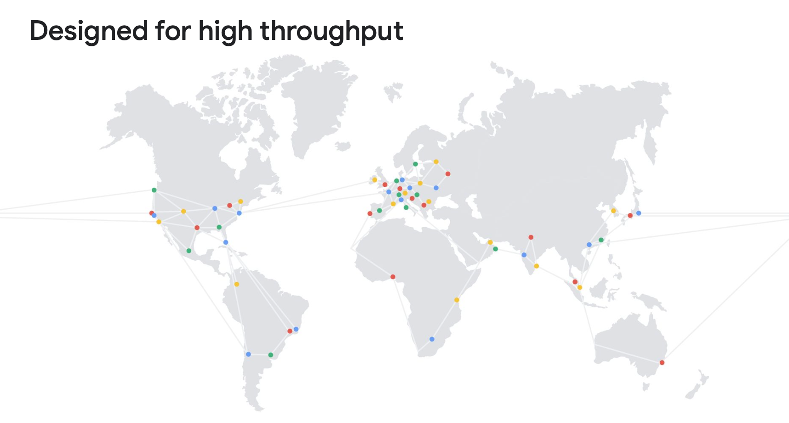
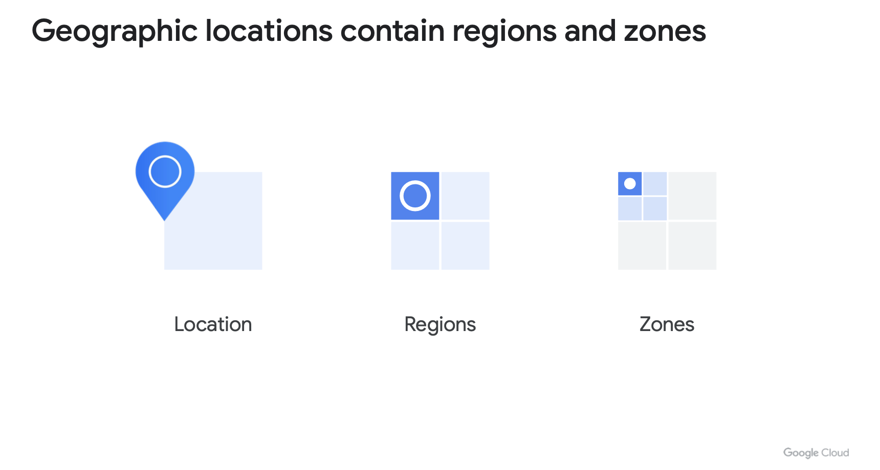
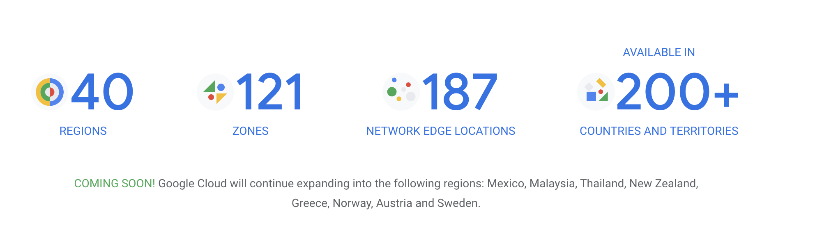
Google cloud platform
Notes:
This slide shows a visual map of all GCP Regions around the world. As you can see, Google has a truly global presence, with regions across North America, South America, Europe, Asia, and beyond. This global footprint means you can deploy your applications close to your users, minimizing latency and ensuring compliance with local data regulations.

Slide 22
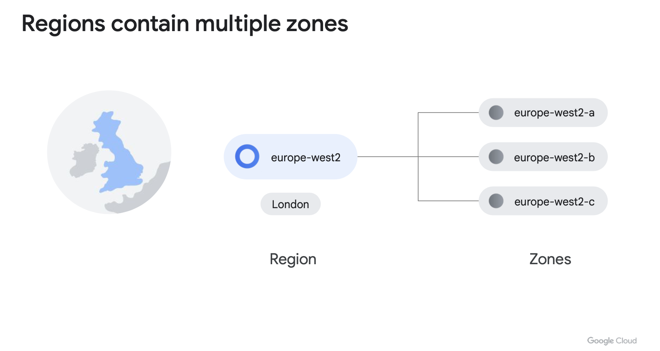
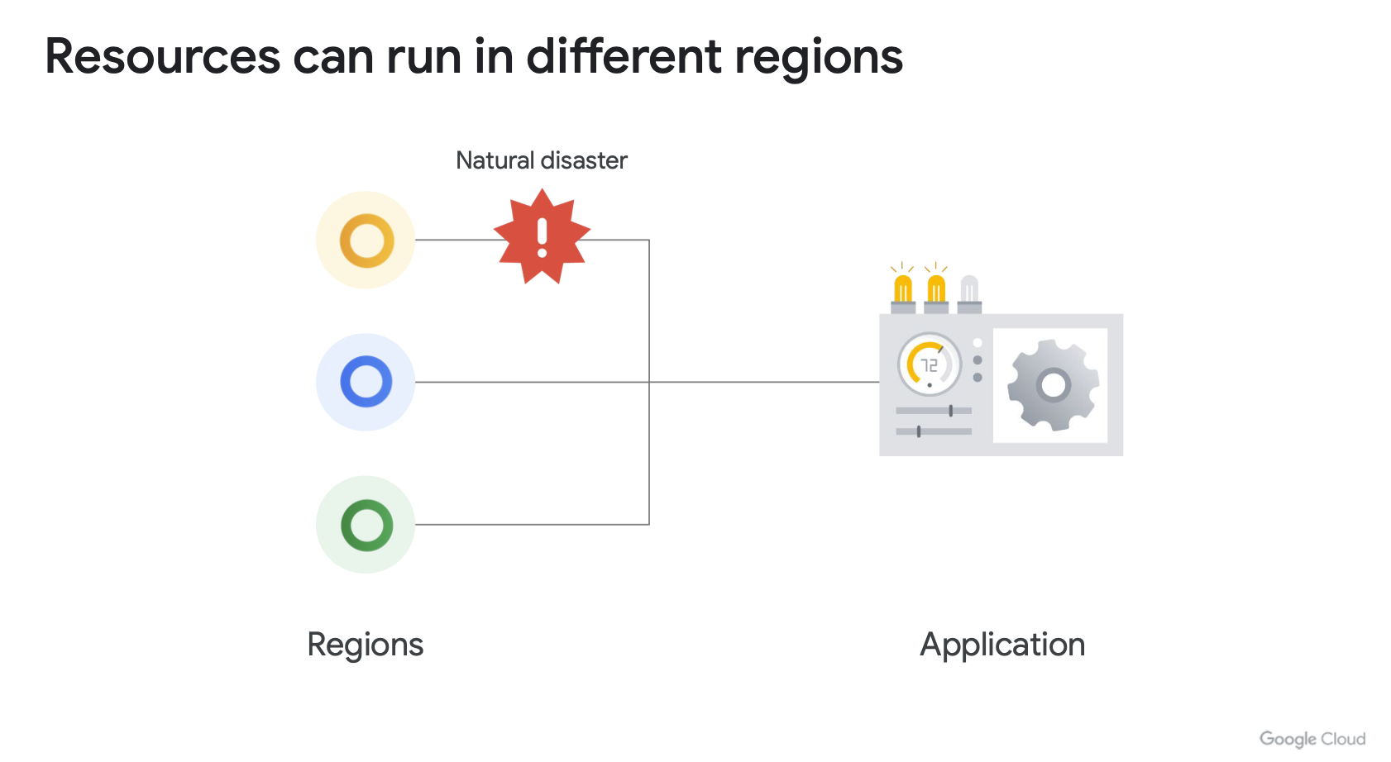
Google cloud platform
Notes:
This diagram illustrates the layered structure of GCP's infrastructure — from the physical hardware at Google's data centers, up through the network fabric, the virtualization layer, the managed services, and finally the tools and APIs that you as developers interact with. This architecture is what enables GCP to deliver services that are fast, reliable, and secure at global scale.

Slide 23
OPERATING SYSTEMS
Notes:
Before we go deeper into cloud services, we need to make sure we all have a solid foundation in Operating Systems — because whether you're managing a VM, deploying a container, or SSHing into a cloud instance, you'll always be interacting with an OS.

Slide 24
OPERATING SYSTEMS
Introduction to Operating Systems:
  Operating systems are software that manage hardware resources and enable the execution of other programs on a computer.
Windows:
  Developed by Microsoft, widely used in office and enterprise environments.
Linux (Unix):
  Family of open-source operating systems based on Unix, used notably in server environments and in the Cloud.
Notes:
An Operating System — or OS — is the software that manages a computer's hardware resources and allows other programs to run on top of it. In the world of cloud and infrastructure, two operating systems dominate: Windows, developed by Microsoft, which is widely used in enterprise office environments and for certain server workloads. And Linux — a family of open-source Unix-based operating systems that is the dominant choice for servers, cloud infrastructure, and anything involving the command line. In virtually all cloud environments, Linux is the default OS. If you've never used Linux before, don't worry — we'll walk through the essentials together.

Slide 25
Windows vs linux
User Interface:
  Windows: User-friendly Graphical User Interface (GUI) with File Explorer.
  Linux: Default Command Line Interface (CLI), but graphical desktop environments are also available.
File Management:
  Windows: Uses drives (C:, D:, etc.) to organize files.
  Linux: Single hierarchical file system (root /) with a standard directory structure.
Security:
  Linux: Known for its robust security, thanks to its granular permissions and user-based security model.
  Windows: Often targeted by malware due to its widespread popularity, but also has advanced security measures.
Notes:
Let's compare Windows and Linux on a few key dimensions. User Interface: Windows is known for its user-friendly Graphical User Interface — GUI — with tools like File Explorer. Linux, by default, uses a Command Line Interface — CLI — though graphical desktop environments like GNOME or KDE are available. File Management: Windows organizes files using drive letters like C: and D:. Linux uses a single hierarchical file system rooted at the forward slash — everything lives under that root directory. Security: Linux is renowned for its robust security model, based on granular file permissions and user-based access control. Windows, due to its widespread use, is more frequently targeted by malware — though it has significantly improved its security features in recent years.

Slide 26
SOME WINDOWS COMMANDS
Command Prompt (CMD) Commands:dir:
  Displays a list of files and directories in the current directory.
  cd: Changes the active directory.
  mkdir: Creates a new directory.
  copy: Copies files.
  del: Deletes files.
  ipconfig: Displays the system's IP configuration.
Notes:
Let's look at some essential Windows command-line commands. These are used in the Command Prompt, or CMD. dir lists the files and directories in your current location. cd changes your current directory. mkdir creates a new folder. copy copies files from one place to another. del deletes files. And ipconfig displays your network configuration, including your IP address. Even if you're a Windows user, knowing these commands makes you much more efficient, especially when working on remote servers without a graphical interface.

Slide 27
Some linux commands
Shell (Bash) Commands:
  ls: Displays a list of files and directories in the current directory.
  cd: Changes the active directory.
  mkdir: Creates a new directory.
  cp: Copies files.
  rm: Deletes files.
  ifconfig: Displays the system's network configuration.
Some Additional Linux-Specific Commands:
  grep: Searches for patterns in files.
  chmod: Modifies permissions of files and directories.
  sudo: Executes a command with administrative privileges.
Notes:
Now for Linux commands — these are used in the shell, typically Bash. ls lists files and directories, equivalent to dir in Windows. cd changes directory. mkdir creates a new directory. cp copies files. rm deletes files — be careful with this one, there's no recycle bin! And ifconfig — or ip a on modern systems — shows your network configuration. Linux also has some powerful commands that don't exist in the same way on Windows: grep allows you to search for patterns inside files, which is incredibly useful for log analysis. chmod modifies file and directory permissions. And sudo allows you to run a command with administrator — or root — privileges.

Slide 28
Why linux commands are important ?
In the Cloud:
  Knowledge of basic commands for navigating, managing, and automating tasks is crucial.
Usage in Cloud Environments:
  Administration of virtual instances, deployment, and management of Cloud services can often be performed via command line interfaces.
Examples of Applications:
  Automation of ETL (Extract, Transform, Load) processes, configuration management, resource monitoring, etc.
Continuous Learning:
  It is recommended to invest time in learning and practicing commands to become more efficient and skilled in the cloud.
Notes:
So why do we spend time on Linux commands in a cloud computing course? Because in the Cloud, the command line is everywhere. When you SSH into a virtual machine, you're dropped into a Linux terminal. When you manage containers, Kubernetes clusters, or deploy scripts, you're using CLI tools. Cloud tools like gcloud, kubectl, and the AWS CLI are all command-line based. Mastering the command line also allows you to automate repetitive tasks — like ETL pipelines, backups, or deployment scripts — which is a core skill for any cloud practitioner. My recommendation: practice every day, even for 15 minutes. The more you use these commands, the more natural they become.

Slide 29
APPLICATION DEPLOYMENT
Notes:
We're now going to talk about Application Deployment — one of the most important topics in this course. Understanding how deployment has evolved will help you make smart decisions about where and how to run your applications.

Slide 30
Evolution of application deployment
Evolution of Technologies and Practices:
  The evolution of technologies and practices has significantly influenced how applications, including websites, are deployed and managed.
Traditional Deployment:
  In the pre-cloud era, deploying a website often involved managing a physical server or a dedicated server in a data center.
Manual and Complex Process:
  Hardware configuration, software installation, management of updates and patches, etc.
Limitations in Scalability and Flexibility:
  Resources were often underutilized, and adjusting capacities was difficult.
Notes:
Let's start at the beginning. In the early days of computing, deploying a web application meant you had to physically set up and manage a server — either on-site or in a co-located data center. The process was entirely manual: you had to configure the hardware, install the operating system, install your software dependencies, manage updates and security patches, and so on. This approach had major limitations. Resources were often underutilized — a server running at 10% capacity most of the time is wasteful. Scaling was difficult — if you needed more capacity, you had to order, install, and configure new hardware, which could take weeks. And any hardware failure meant downtime.

Slide 31
Evolution of application deployment
The Emergence of Virtualization and Cloud Computing:
  Virtualization has enabled the creation of virtual machines (VMs), offering better utilization of hardware resources.
  Cloud Computing has introduced Infrastructure as a Service (IaaS), Platform as a Service (PaaS), and Software as a Service (SaaS) offerings, providing increased scalability and agility.
  Deployment on virtual servers or Cloud services allows simplified management, on-demand scalability, and cost reduction.
Notes:
The emergence of Virtualization changed everything. Instead of one application per physical server, virtualization allowed running multiple Virtual Machines on a single physical machine — each with its own operating system, applications, and resources. This improved hardware utilization dramatically. Then came Cloud Computing, which introduced three delivery models: IaaS — Infrastructure as a Service — where you rent virtual machines and raw compute resources. PaaS — Platform as a Service — where you get a managed environment to run your applications without worrying about the underlying OS. And SaaS — Software as a Service — where you simply use a fully managed application like Gmail or Salesforce. Deploying on Cloud virtual servers simplified management, enabled on-demand scaling, and reduced costs significantly.

Slide 32
Evolution of application deployment
The Era of Containerization and Orchestration:
  Containerization with tools like Docker has introduced lightweight and portable environments for running applications.
  Kubernetes has become the de facto leader in container orchestration, enabling automated deployment, scaling, and management of containerized applications.
  Simplification of deployment, reduction of dependencies and conflicts, and acceleration of development cycles through automation.
Notes:
The next major evolution was Containerization. Docker introduced the concept of containers — lightweight, portable, self-contained units that package an application and everything it needs to run: the code, the runtime, the libraries, the configuration. Unlike VMs, containers don't need a full operating system — they share the host OS kernel, making them much faster to start and much lighter. But managing hundreds of containers manually is complex — that's where Kubernetes comes in. Kubernetes is the de facto standard for container orchestration: it automates deployment, scaling, load balancing, and self-healing of containerized applications. This combination has revolutionized how modern applications are built and deployed.

Slide 33
Evolution of application deployment
The Emergence of Serverless Computing:
  Serverless Computing, also known as Functions-as-a-Service (FaaS), allows running code without managing the underlying infrastructure.
  Cloud providers offer Serverless platforms such as AWS Lambda, Google Cloud Functions, and Azure Functions.
  Rapid deployment, automatic scalability, pay-per-use billing, ideal for on-demand workloads and event-driven applications.
  In practice, it's a Python or JS function, for example, that applies processing to something. This processing is triggered by a trigger (an event: file upload, API call, etc.).
Notes:
The most recent evolution is Serverless Computing — also known as Functions-as-a-Service or FaaS. With serverless, you don't manage any servers at all — you just write a function, upload it, and the cloud provider takes care of everything: provisioning, scaling, patching, and billing. You're only charged for the actual execution time of your code — down to the millisecond. Major serverless platforms include AWS Lambda, Google Cloud Functions, and Azure Functions. Serverless is perfect for event-driven workloads — things like processing a file when it's uploaded to storage, responding to an API call, or triggering a notification. For example, a Python function that runs every time a new image is uploaded to a bucket — it could resize it, classify it using a machine learning model, and save the result. No servers needed.

Slide 34
Evolution of application deployment
Conclusion :
  The evolution of application deployment, from traditional methods to modern Cloud Computing and Serverless technologies, has significantly transformed how applications are designed, deployed, and managed.
  Companies now have access to sophisticated tools and platforms to meet the needs of their applications, ensuring maximum scalability, agility, and operational efficiency.
Notes:
Let's recap this evolution. From bare-metal servers, to virtual machines, to containers with Kubernetes, to fully serverless functions — each step has brought us more efficiency, more scalability, and less operational overhead. Today, companies have access to a wide spectrum of deployment options. The right choice depends on the specific needs of your application: how much control you need, how predictable your traffic is, how much you want to manage yourself, and what your budget looks like. Throughout the rest of this course, we'll explore all of these options hands-on.

Slide 35
LA VIRTUALISATION
Notes:
Let's now dive deeper into Virtualization — the technology that made the Cloud possible.

Slide 36
VIRTUALISATION
Introduction to Virtualization:
  Virtualization is a technology that allows creating multiple isolated virtual environments on the same physical hardware.
History of Virtualization:
  Initial development in the 1960s with the first virtualization systems for mainframe computers.
  Increasing adoption in the 2000s with the popularization of x86 virtualization technologies.
  Evolution towards container virtualization in the 2010s with the emergence of Docker and Kubernetes.
Notes:
Virtualization is the technology that allows you to create multiple isolated virtual environments — called Virtual Machines — on a single physical server. This concept dates back to the 1960s, when IBM first experimented with virtualizing mainframe computers. It gained widespread adoption in the early 2000s with x86 virtualization technologies from companies like VMware. And in the 2010s, the concept evolved further with container virtualization, thanks to Docker and Kubernetes. Understanding virtualization is fundamental because every virtual machine you create in the Cloud — whether it's on GCP, AWS, or Azure — is built on this technology.

Slide 37
VIRTUALISATION – virtual machines
Definition of Virtual Machines:
  Virtual Machines are virtual computer environments that function as standalone operating systems on a single physical hardware.
Use Cases of Virtual Machines:
  Isolation of Applications:
    Each VM can run applications and services in isolation, ensuring security and stability.
  Development and Testing:
    Creation of independent development and test environments for applications.
  Server Consolidation:
    Running multiple workloads on a single physical server for efficient resource utilization.
Notes:
A Virtual Machine — or VM — is a complete, isolated computing environment that runs on top of physical hardware through a software layer called a Hypervisor. From the inside, a VM looks and behaves just like a real physical computer — it has its own CPU, memory, storage, and operating system. Virtual Machines are used for many purposes: Isolation — each VM can run its own applications without interfering with others. Development and Testing — you can spin up a VM, test your application, and discard it when done, without any risk to your real environment. Server Consolidation — instead of one application per physical server, you can run ten VMs on one physical machine, dramatically improving resource utilization.

Slide 38
VIRTUALISATION – virtual machines
Hypervisor (or Virtual Machine Monitor):
  Software responsible for managing VMs and allocating physical resources.
Virtual Machines:
  Each VM contains a complete operating system, including the kernel, drivers, and applications.
  The hypervisor manages physical resources and allows multiple VMs to run on a single physical server.
Notes:
Let's look at how Virtual Machines work technically. The key component is the Hypervisor — also called a Virtual Machine Monitor. The Hypervisor is a software layer that sits between the physical hardware and the VMs. It manages the allocation of physical resources — CPU, memory, storage — to each VM, and ensures they remain isolated from each other. Each VM contains a complete operating system — including the kernel, drivers, and applications — making them fully independent from other VMs on the same host. This architecture allows multiple VMs to run simultaneously on a single physical server, each thinking they have exclusive access to the hardware.

Slide 39
VIRTUALISATION - containers
Definition of Docker Containers:
  Docker containers are lightweight and portable instances of software applications, bundling everything they need to run, including code, libraries, and dependencies.
Use Cases of Docker Containers:
  Application Deployment:
    Docker containers facilitate the deployment of applications in any environment, whether it's a local server, a public cloud, or a hybrid cloud.
  Consistent Development Environments:
    Containers ensure that development environments are consistent across teams, thereby avoiding compatibility issues.
  Microservices:
    Containers are often used in a microservices architecture to encapsulate each service in an isolated and scalable manner.
Notes:
Now let's talk about Docker Containers — a lighter alternative to Virtual Machines. A Docker container is a lightweight, portable package that contains everything an application needs to run: the code, the runtime environment, the libraries, and all dependencies. Containers are ideal for Application Deployment because they run consistently across different environments — from your laptop to a cloud server. They ensure Consistent Development Environments, meaning a developer's code will behave the same way on any machine. And they're perfect for Microservices architectures, where each service is independently packaged, deployed, and scaled in its own container.

Slide 40
VIRTUALISATION - containers
Docker Engine:
  Containerization platform for creating, managing, and running containers.
Main Components:
  Docker Daemon, Docker Client, Docker Registry.
Containers:
  Containers share the same kernel as the host operating system.
  They only include the libraries and dependencies required for the application, making them lightweight and portable.
Notes:
Docker works through a component called the Docker Engine, which is the containerization platform responsible for building, managing, and running containers. The main components are: the Docker Daemon — a background service that manages containers; the Docker Client — the command-line tool you use to interact with Docker; and Docker Registry — a repository where container images are stored and shared, like Docker Hub. The key difference from VMs: containers share the same OS kernel as the host. They only package the application-specific libraries and dependencies, which makes them extremely lightweight — we're talking megabytes versus gigabytes — and very fast to start, often in milliseconds.

Slide 41
VIRTUALISATION – KUBERNETES
Definition of Kubernetes:
  Kubernetes is an open-source container orchestration management system designed to automate the deployment, scaling, and management of containerized applications.
Use Cases of Kubernetes:
  Container Orchestration:
    Kubernetes simplifies the management of a large number of containers by automating tasks such as deployment, scaling, and resource management.
  High Availability:
    Kubernetes ensures application availability and resilience by automatically redeploying containers in case of failure.
  Multi-Cloud Deployments:
    Kubernetes is used to orchestrate application deployments across multiple cloud environments, enabling workload portability.
Notes:
When you have dozens or hundreds of containers, managing them manually becomes impossible. That's where Kubernetes comes in. Kubernetes — often abbreviated as K8s — is an open-source container orchestration system that automates the deployment, scaling, and management of containerized applications. Use cases include: Container Orchestration — Kubernetes handles the complexity of managing large numbers of containers across multiple hosts. High Availability — if a container crashes, Kubernetes automatically restarts it on a healthy node. And Multi-Cloud Deployments — Kubernetes can run on any cloud provider or on-premises, making your applications highly portable.

Slide 42
VIRTUALISATION – KUBERNETES
Kubernetes:
  Open-source container orchestration system for automating the deployment, scaling, and management of containerized applications.
Architecture of Kubernetes:
  Master:
    Main components: API Server, Scheduler, Controller Manager, and etcd.
  Nodes:
    Main components: Kubelet, Kube-proxy, and Container Runtime.
  Pods:
    Basic unit in Kubernetes, containing one or more containers.
  Services:
    Abstraction that defines a set of pods and an access policy to these pods.
Notes:
Let's look at the Kubernetes architecture. A Kubernetes cluster consists of a Master — also called the Control Plane — and multiple worker Nodes. The Master is responsible for managing the cluster state. Its key components are the API Server, which is the entry point for all administrative commands; the Scheduler, which assigns workloads to nodes; the Controller Manager, which ensures the desired state of the cluster; and etcd, a distributed key-value store for cluster state data. The worker Nodes are where the actual application containers run. Each node runs a Kubelet — an agent that communicates with the master — a Kube-proxy for network routing, and a Container Runtime like Docker or containerd. The basic deployment unit in Kubernetes is a Pod — a group of one or more containers that share resources and network. Services abstract a set of pods and provide a stable network endpoint to reach them.

Slide 43
VMs vs containers
Virtual Machines (VMs):
  Isolation:
    Each VM contains a complete operating system, offering full isolation of hardware resources.
  Size:
    VMs are larger due to the inclusion of a complete operating system and necessary applications.
  Startup Time:
    VMs take longer to start as they need to load a complete operating system.
  Resource Usage:
    VMs consume more resources due to the overhead of the operating system.
Containers:
  Isolation:
    Containers share the same kernel as the host operating system, offering lightweight isolation.
  Size:
    Containers are lighter as they share the same kernel as the host operating system and only include necessary libraries and dependencies for the application.
  Startup Time:
    Containers start quickly as they do not need to load a complete operating system.
  Resource Usage:
    Containers consume fewer resources as they avoid the overhead of the operating system.
Notes:
Let's directly compare Virtual Machines and Containers. Isolation: VMs offer full hardware isolation — each one has its own complete OS. Containers share the host OS kernel, so their isolation is lighter but still effective for most use cases. Size: VMs are heavy — a typical VM image is several gigabytes because it includes a full OS. Containers are lightweight — often just a few hundred megabytes — because they only include app-specific dependencies. Startup Time: VMs take minutes to boot because they load a full operating system. Containers start in seconds or even milliseconds. Resource Usage: VMs consume significant resources due to OS overhead. Containers are much more efficient and allow higher density on the same hardware.

Slide 44
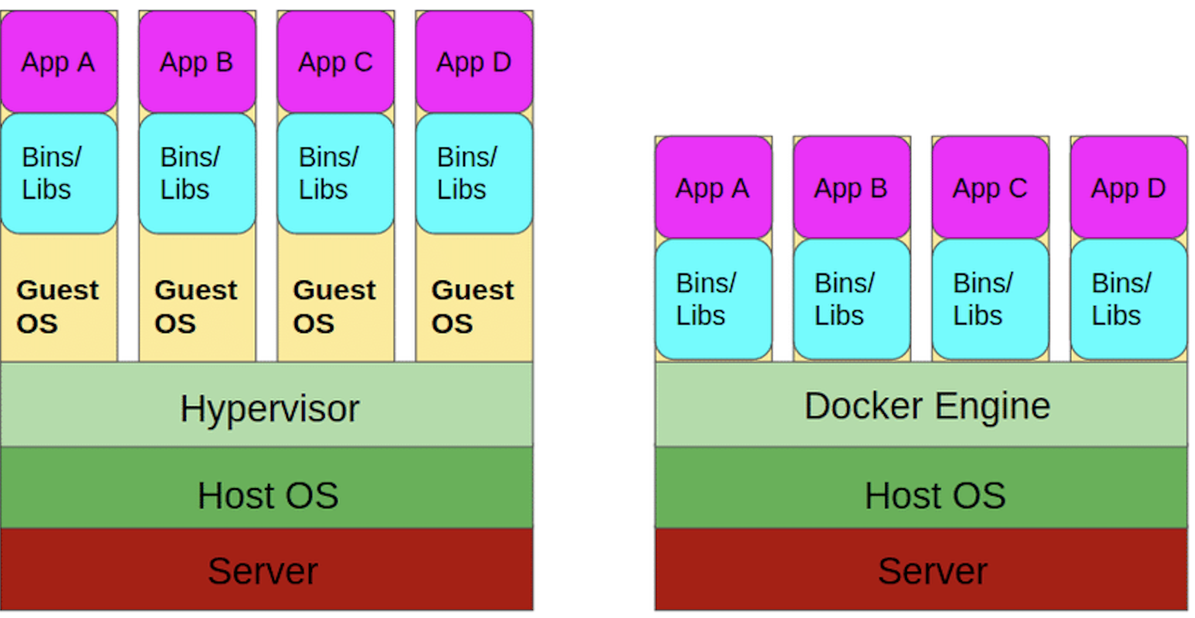
VMs vs containers
Notes:
This diagram visually summarizes the difference between the architecture of Virtual Machines and Containers. On the left, you can see VMs — each with its own Guest OS running on top of the Hypervisor. On the right, containers — sharing the same Host OS kernel, with only the application layer being isolated. This architectural difference explains why containers are lighter, faster, and more portable than VMs.

Slide 45
VIRTUALISATION - CONCLUSION
Virtual Machines (VMs):
  Offer complete isolation but are heavier and consume more resources.
Containers:
  Offer lightweight isolation, are lightweight, and start quickly.
Kubernetes:
  Simplifies the deployment and management of containerized applications at scale by automating orchestration tasks.
Choice Depends on Specific Business Needs:
  Depends on the specific needs of the business in terms of isolation, performance, and resource management.
Notes:
To conclude this virtualization section: VMs offer complete isolation and are ideal when you need full OS-level separation — for example, running Windows and Linux workloads on the same host. Containers are ideal for microservices, fast deployment, and cloud-native applications where lightweight and portability matter most. Kubernetes bridges the gap by automating the deployment and lifecycle management of containers at any scale. The right choice always depends on your specific requirements: how much isolation do you need? How fast must deployments be? How much operational complexity can your team handle? In cloud environments, you'll often use a combination of all three.

Slide 46
DEMO : Deploying a machine learning app
Notes:
Now for the part many of you have been waiting for — the Demo! We're going to see step by step how to deploy a real Machine Learning application across different platforms. This will make everything we've discussed much more concrete and hands-on.

Slide 47
ML APP DEPLOYMENT
In this section, we will explore how deploying a developed Streamlit application can be achieved on various platforms, from a local VM to managed cloud services like Google Cloud Run and Google Cloud Functions.
Notes:
In this section, we'll explore the full journey of deploying a Streamlit machine learning application — from running it on a local virtual machine all the way to deploying it as a fully managed service on Google Cloud. We'll cover deployment on a local VM or physical server, on a GCP Compute Engine VM, inside a Docker container, on Google Cloud Run, and as a Google Cloud Function. Each approach has its own advantages and trade-offs, and by the end of this section, you'll have a clear picture of when to use which method.

Slide 48
ML APP DEPLOYMENT
Deployment Steps on a Virtual Machine or Local Server:
  Download and install virtualization software.
  Download a Debian 12 operating system image.
  Create a Debian virtual machine in VMware.
  Install Python and necessary dependencies.
  Transfer the Streamlit application to the virtual machine.
  Configure ports and the web server (e.g., Gunicorn).
  Launch the application and test its accessibility from a browser.
  Update and maintain the virtual machine.
  Cost of the VM in the data center: functional and logistical costs.
Deployment Steps on a Virtual Machine on GCP:
  Create and configure a Debian virtual machine in Compute Engine.
  Install Python and necessary dependencies.
  Transfer the Streamlit application to the virtual machine.
  Configure ports and the web server (e.g., Gunicorn).
  Launch the application and test its accessibility from a browser.
  Pay only when the VM is running.
Notes:
Let's start with the most traditional approach: deploying on a Virtual Machine. For a local server or VM, the process goes like this: first, download and install virtualization software — like VMware or VirtualBox. Then download a Debian 12 OS image. Create a Debian VM and install Python and all the necessary libraries. Transfer the Streamlit application files to the VM. Configure the web server — typically using Gunicorn — and open the necessary ports. Launch the application and verify it's accessible from a browser. Don't forget that running a VM in a data center comes with real costs: hardware, electricity, cooling, physical space, and IT staff to maintain it. On GCP Compute Engine, the process is very similar, but you create the VM in the cloud console, and you only pay while the VM is running. This is already a big improvement over physical servers.

Slide 49
ML APP DEPLOYMENT
Deployment Steps in a Docker Container:
  Build the Docker image from a Dockerfile.
  Run the Docker container locally for verification.
  Publish the image to Docker Hub or a private registry.
  Deploy and run the image on any machine with Docker installed.
Notes:
The next step up is deploying in a Docker container. This approach offers much more portability and reproducibility. The steps are: write a Dockerfile that describes your application's environment and dependencies. Build a Docker image from that Dockerfile. Run the container locally to verify everything works. Push the image to Docker Hub or a private container registry. From that point, you can run the exact same container on any machine that has Docker installed — whether it's your laptop, a colleague's machine, a VM on GCP, or any other cloud provider. This "build once, run anywhere" approach is one of the biggest advantages of containerization.

Slide 50
ML APP DEPLOYMENT
Deployment Steps in Cloud Run:
  Prepare the Docker image of the Streamlit application.
  Deploy the image to Google Cloud Run via the Cloud console or the command-line interface (CLI).
  Configure parameters such as allocated resources and automatic scaling.
  An image will be automatically built and pushed to a private registry on GCP.
  Access the application via a URL provided by Google Cloud Run.
Notes:
Building on Docker, we can deploy to Google Cloud Run — a fully managed serverless container platform. The steps are: first, prepare your Docker image of the Streamlit application. Deploy it to Cloud Run via the Google Cloud Console or the gcloud CLI. Configure parameters like memory, CPU, and concurrency settings. Cloud Run will automatically build and push the image to a private registry called Artifact Registry on GCP. Once deployed, Cloud Run provides a unique HTTPS URL for your application. Cloud Run automatically scales the number of running containers based on incoming traffic — from zero to thousands of instances — and you only pay for the actual requests being processed.

Slide 51
ML APP DEPLOYMENT
Deployment Steps in a Cloud Function:
  Transform the Streamlit application into an asynchronous function managed by Google Cloud Functions.
  Deploy the function to Google Cloud Functions via the Cloud console or the CLI.
  Configure triggers (e.g., HTTP) to invoke the function.
  Test the function invocation using a tool like curl or via a browser.
Notes:
For even more serverless usage, you can deploy as a Google Cloud Function. The process involves transforming your Streamlit application into an asynchronous function managed by Cloud Functions. You deploy it via the Cloud Console or CLI, configure a trigger — typically an HTTP trigger — and test it using a browser or a tool like curl. Cloud Functions is ideal for lightweight, event-driven processing. However, it's worth noting that Streamlit isn't naturally designed for serverless functions — Cloud Run is usually the better fit for Streamlit apps. Cloud Functions shine more for background tasks like file processing, notifications, or data transformation pipelines.

Slide 52
ML APP DEPLOYMENT
In Conclusion:
Choice depends on the needs, skills, and constraints of each project:
  VMs may offer total flexibility while managed cloud services (like Cloud Run) offer simplified management and automatic scaling.
It is essential to explore and experiment with different options to find the one that best suits each use case.
Notes:
So, which deployment method should you choose? The answer is: it depends on your project's specific needs, your team's skills, and your constraints. Virtual Machines give you total flexibility and control — you can install anything, configure anything. But they require more management effort. Managed cloud services like Cloud Run offer simplified management, automatic scaling, and you only pay for actual usage — but you have less control over the underlying infrastructure. As a rule of thumb: use VMs when you need full control or have legacy applications. Use Cloud Run for containerized web applications that need to scale. Use Cloud Functions for lightweight, event-driven processing tasks. The key is to experiment with each option to understand its strengths and limitations for your specific use case.

Slide 53
GCP SERVICES THAT YOU MUST KNOW
Notes:
We've covered deployment. Now let's take a broader look at the most important GCP services you need to know as a cloud practitioner. These are the building blocks you'll use to architect real-world solutions.

Slide 54
SECURITY
Custom Design:
  Google designs its own server racks and network equipment for its data centers, as well as custom chips, including a hardware security chip.
Boot Security:
  Google's server machines use cryptographic signature technologies to ensure they boot with the correct software.
Physical Security:
  Google designs and constructs its own data centers with multiple layers of physical protection, limiting access to a small number of employees. Additional security measures are in place for servers hosted in third-party data centers.
Communication Encryption:
  Google automatically encrypts all RPC (Remote Procedure Call) traffic between its data centers and deploys cryptographic accelerators to extend encryption to all RPC traffic within its data centers.
User Identity:
  Google's identity service goes beyond just username and password by requesting additional information based on risk factors. It also supports secondary authentication factors like U2F (Universal 2nd Factor).
Encryption at Rest:
  Most data is stored via storage services with encryption enabled by centrally managed keys, and Google also supports hardware encryption on hard drives and SSDs (Solid State Drives).
Notes:
Security is foundational to everything Google Cloud does, and it starts at the hardware level. Google designs its own server racks, network equipment, and even custom security chips — meaning security is baked in from day one. Boot Security: Google servers use cryptographic signatures to ensure they only boot with trusted, verified software. Physical Security: Google's data centers are built with multiple layers of physical protection — biometric access, security cameras, and limited staff access. Communication Encryption: all internal traffic between Google's data centers is automatically encrypted. And Encryption at Rest: all data stored in Google's infrastructure is encrypted using centrally managed keys. Additionally, Google's Identity service provides strong authentication — it goes beyond username and password by using risk-based factors and supports hardware security keys like U2F.

Slide 55
SECURITY
Google Front End (GFE):
  Google services on the internet use the Google Front End (GFE) for secure connections via TLS (Transport Layer Security). The GFE provides X.509 certificates and public-private keys, as well as protections against DoS (Denial of Service) attacks.
Protection against Denial of Service (DoS) Attacks:
  Google can absorb many DoS attacks thanks to its large-scale infrastructure and has multiple protections to mitigate risks on services behind the GFE.
Intrusion Detection:
  Rules and artificial intelligence alert security teams to potential incidents. Regular exercises are conducted to enhance detection and response.
Mitigation of Internal Risks:
  Google closely monitors the activities of employees with administrative access to the infrastructure to reduce internal risks.
Use of U2F by Employees:
  Google employees are required to use U2F-compatible security keys to protect against phishing and other attacks.
Software Development Practices:
  Google employs centralized code control and two-party reviews. Developers have access to libraries to avoid security bugs. Additionally, a Vulnerability Rewards Program encourages the discovery and resolution of bugs in Google's infrastructure and applications.
Notes:
Google's security architecture also covers network-level protection. The Google Front End — or GFE — handles all internet-facing connections using TLS encryption and provides X.509 certificates, ensuring all communications are secure. Google's infrastructure can absorb massive DDoS attacks thanks to its global scale. Intrusion Detection: Google uses both rule-based systems and AI to detect and alert on potential security incidents, with regular internal exercises to sharpen response capabilities. To reduce insider risk, Google closely monitors the activities of employees with privileged access to infrastructure. All Google employees are required to use U2F hardware security keys to prevent phishing. And on the development side, Google uses centralized code review, two-party approval processes, and has a Vulnerability Rewards Program that incentivizes the responsible disclosure of bugs.

Slide 56
OPEN SOURCE
Concerns about Vendor Lock-In:
  Some fear being locked in with a single cloud provider.
Google's Approach:
  Google allows customers to switch providers if needed.
  Google utilizes open-source licenses to provide alternatives.
  Google ensures interoperability at various levels of the technology stack.
Notes:
One legitimate concern many companies have about cloud is vendor lock-in — the fear of becoming too dependent on a single cloud provider and being unable to switch later. Google's approach to addressing this is through openness. Google actively uses and contributes to open-source technologies, ensuring that the tools and frameworks you use on GCP — like Kubernetes, TensorFlow, and Apache Beam — are not proprietary. Google also ensures interoperability across different layers of the technology stack. This means you can build on GCP with the confidence that you're not trapped — your workloads can be migrated or run on other platforms if your needs change.

Slide 57
pricing
Google Cloud Billing Practices:
  Google was the first major cloud provider to offer per-second billing for its Compute Engine service.
  Per-second billing is available for Compute Engine, Google Kubernetes Engine, Dataproc, and App Engine flexible environment VMs.
  Compute Engine also offers automatically applied sustained use discounts, custom machine types, and an online pricing calculator for cost estimation.
Tools for Cost Management:
  Budget definition at the account or project level.
  Alerts creation when costs approach budget limits.
  Use of reports to monitor expenses.
  Implementation of quotas to prevent resource overconsumption.
Types of Quotas:
  Rate quotas and allocation quotas applied at the project level and reset at specific intervals.
  Projects start with the same quotas, but some can be adjusted by requesting an increase from Google Cloud support.
Notes:
Let's talk about pricing — because understanding how you're billed is essential for controlling costs in the Cloud. Google was actually the first major cloud provider to introduce per-second billing for Compute Engine VMs. This means if your VM runs for 47 seconds, you only pay for 47 seconds — not a full minute or hour. Per-second billing also applies to GKE, Dataproc, and App Engine flexible VMs. Compute Engine also offers sustained use discounts — automatically applied if you run a VM for a significant portion of the month. For cost management, GCP provides budget tools: you can define budgets at the account or project level, create alerts when costs approach your budget, use reports to visualize spending, and set quotas to prevent unexpected resource consumption. There are two types of quotas: rate quotas that reset periodically, and allocation quotas that cap the total resources you can have at any time.

Slide 58
The hierarchy of GCP resources
The hierarchy of GCP resources comprises four levels: resources, projects, folders, and organization node.
Resources such as virtual machines, Cloud Storage buckets, etc., are at the lowest level.
Projects group resources and are situated at the second level of the hierarchy.
Folders, along with any subfolders, are at the third level and can be used to organize projects.
The organization node, at the highest level, encompasses all projects, folders, and resources.
Policy management is tied to this hierarchy: policies can be defined at the project, folder, and organization node levels.
Some Google Cloud services also allow policy enforcement at the individual resource level.
Policies are inherited downwards: a policy applied to a folder will apply to all projects it contains.
Notes:
Understanding how GCP resources are organized is critical for managing access and billing. GCP uses a four-level hierarchy. At the bottom are individual Resources — like VMs, storage buckets, and databases. Resources are grouped into Projects — this is the fundamental organizing unit in GCP. Projects are organized into Folders, which can contain subfolders, allowing you to mirror your company's organizational structure. And at the very top is the Organization Node, which encompasses everything. This hierarchy is important for policy management: you can set access policies and permissions at any level — organization, folder, or project — and those policies are inherited downward. For example, a security policy applied to a folder automatically applies to all projects within that folder.

Slide 59
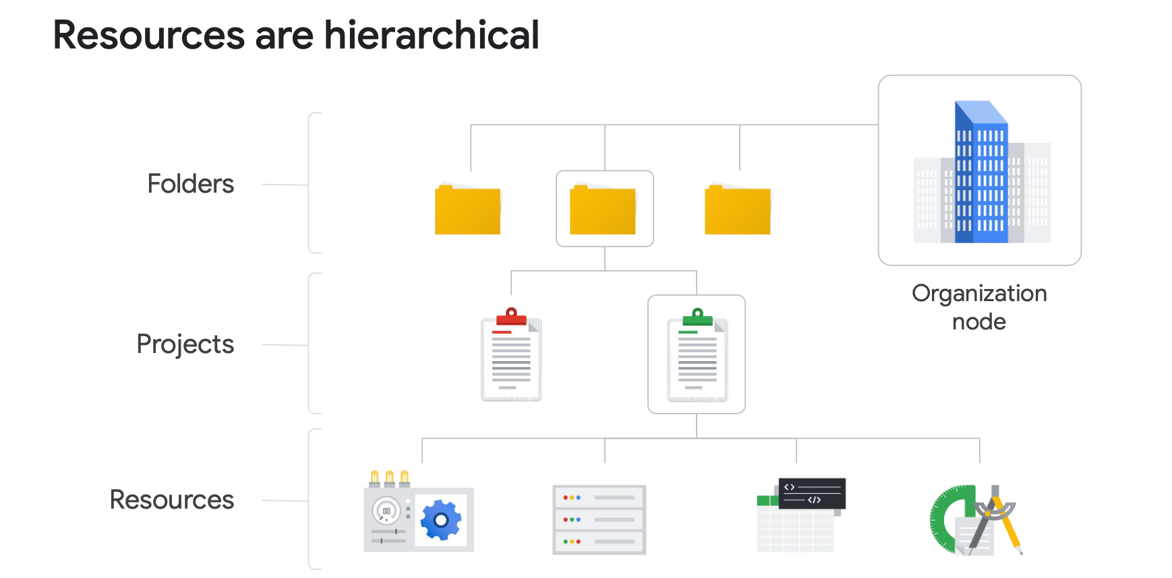
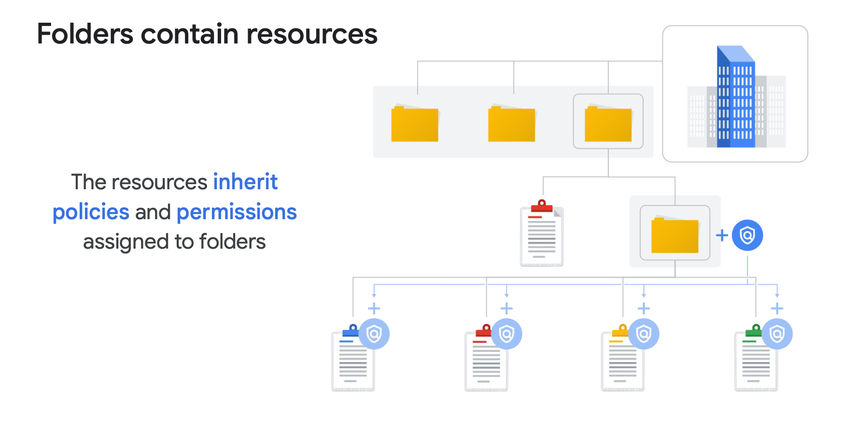
hierarchy
Notes:
This diagram illustrates the GCP resource hierarchy visually. Notice how policies flow from top to bottom — the organization node at the top, then folders, then projects, and finally individual resources. This inheritance model makes it easy to apply consistent security and compliance policies across your entire organization without having to configure each resource individually.

Slide 60
IAM
There are three types of roles in IAM: basic, predefined, and custom.
Basic roles have broad scope and affect all resources within a Google Cloud project when applied. They include owner, editor, viewer, and billing administrator.
Predefined roles are specific to certain Google Cloud services and define a set of predefined actions. For example, Compute Engine offers predefined roles like "instanceAdmin" to manage specific resources.
Custom roles are used to assign more specific permissions following the principle of "least privilege." For example, creating an "instanceOperator" role to allow certain users to manage virtual machines without the ability to reconfigure them.
Service accounts are used to authenticate virtual machines with Google Cloud services. They are associated with an email address and use cryptographic keys to access resources.
The roles assigned to a service account determine the actions that an application running on a virtual machine with that account can perform, such as creating, modifying, or deleting other virtual machines.
Notes:
IAM stands for Identity and Access Management — it's the system GCP uses to control who can do what on which resources. There are three types of IAM roles. Basic roles are the broadest — they affect all resources within a project. They include Viewer, Editor, Owner, and Billing Administrator. These are simple but often too permissive for production use. Predefined roles are service-specific and define a precise set of allowed actions — for example, a Compute Engine instanceAdmin role that allows managing VMs but nothing else. Custom roles allow you to define exactly the permissions you need, following the principle of least privilege — giving users only the access they actually need. Service Accounts are special identities used by applications and VMs to authenticate with GCP services. For example, a VM running your application can be assigned a service account with only the permissions that application needs.

Slide 61
IAM
QUIZ :
Choose the correct completion: Services and APIs are enabled on a per-__________ basis.
  A: Folder
  B: Project
  C: Organization
  D: Billing account
QUIZ 2
Order these IAM role types from broadest to finest-grained.
  A: Custom roles, predefined roles, basic roles
  B: Predefined roles, custom roles, basic roles
  C: Basic roles, predefined roles, custom roles
Notes:
Let's test your understanding with two quick quiz questions. Quiz 1: Services and APIs are enabled on a per-blank basis — Folder, Project, Organization, or Billing Account? The correct answer is B — Project. Each GCP project has its own set of enabled APIs and services. Quiz 2: Order these IAM role types from broadest to finest-grained — the options are combinations of Custom, Predefined, and Basic roles. The correct answer is C — Basic roles are the broadest, Predefined roles are more specific, and Custom roles are the most fine-grained. Understanding this hierarchy helps you choose the right role type for each situation.

Slide 62
VPC
A Virtual Private Cloud (VPC) is a secure and private cloud computing model hosted within a public cloud, such as Google Cloud.
Clients can run code, store data, host websites, and perform all other tasks possible in a regular private cloud on a VPC.
VPCs combine the scalability and convenience of public cloud with the data isolation of private cloud.
VPC networks connect Google Cloud resources to each other and to the internet, including network segmentation, firewall rule usage, and static route creation.
A surprising aspect for many new Google Cloud users: Google VPC networks are global and can have subnetworks, which are segmented parts of the larger network, in any Google Cloud region worldwide.
Subnetworks can cover the zones that make up a region, allowing for global networking, and resources can even be in different zones on the same subnetwork.
Notes:
A Virtual Private Cloud — or VPC — is a logically isolated network within Google Cloud where you can deploy and connect your resources securely. Despite using public cloud infrastructure, a VPC gives you the privacy and control of a private network. With a VPC, you can segment your network, apply firewall rules to control traffic, and define static routes for network communication. One important thing that surprises many GCP newcomers: GCP VPC networks are global — a single VPC can span multiple regions around the world. Within a VPC, you create Subnets — which are regional. A subnet in europe-west1 and a subnet in us-central1 can both be part of the same global VPC. Resources in different zones can even be on the same subnet, which makes designing highly available architectures much simpler.

Slide 63
COMPUTE ENGINE
Compute Engine allows users to create and run virtual machines on Google's infrastructure without any upfront investments.
Each virtual machine provides full operating system capabilities and can be configured according to CPU, memory, storage, and operating system requirements.
Instances can be created via the Google Cloud Console, CLI, or Compute Engine API.
Compute Engine offers several storage options with unique pricing and performance characteristics.
Custom machine types enable precise selection of instance properties based on requirements.
Persistent disks are recommended for storage needs.
Overall, it is flexible, high-performing, and billed based on actual usage.
Notes:
Google Compute Engine is GCP's core IaaS offering — it allows you to create and run virtual machines on Google's infrastructure with no upfront investment. You can configure each VM precisely: choose the number of CPUs, the amount of RAM, the type and size of storage, and the operating system. VMs can be created through the Cloud Console, the gcloud command-line tool, or the Compute Engine API. Compute Engine offers custom machine types — meaning you're not limited to predefined sizes. You can request exactly the combination of CPU and memory that your workload needs. For storage, persistent disks are the recommended choice — they survive VM restarts and can be resized dynamically. Compute Engine is billed based on actual usage, with per-second billing and automatic sustained use discounts.

Slide 64
GOOGLE CLOUD marketplace
Google Cloud Marketplace is an online platform that allows users to discover, deploy, and manage pre-configured and certified third-party software on Google Cloud Platform (GCP).
Users browse the software catalog, select solutions that meet their needs, and deploy them on their GCP infrastructure with a few clicks.
It offers pre-configured services like databases, web services, etc., based on GCP services like Compute Engine (instead of initiating an empty VM and installing a database, etc.).
The benefits of Google Cloud Marketplace are numerous. Firstly, it provides a wide variety of software and tools, enabling users to quickly find solutions for their specific needs. Additionally, Google Cloud Marketplace ensures compatibility and security of listed software, offering users peace of mind when deploying third-party solutions. Furthermore, Google Cloud Marketplace simplifies the purchasing and billing process, allowing businesses to easily manage their software expenses.
However, there are a few drawbacks to consider. While Google Cloud Marketplace offers great convenience, some software may have additional costs associated with their use, which can increase overall company expenses. Additionally, users must exercise due diligence when selecting software solutions, ensuring they meet their requirements in terms of features, performance, and security.
Notes:
Google Cloud Marketplace is an online catalog of pre-configured, certified third-party software solutions ready to deploy on GCP. Instead of starting with an empty VM and manually installing and configuring software, you can find pre-built solutions — databases, web servers, security tools, business applications — and deploy them in just a few clicks. The benefits are significant: you get a wide variety of solutions, all tested for compatibility with GCP. Deployment is fast and reliable. Billing is consolidated — software costs are added directly to your GCP bill. However, there are some important caveats: some Marketplace solutions come with additional licensing costs on top of the underlying GCP infrastructure costs. And as always, you should verify that any third-party software meets your requirements in terms of functionality, performance, and security before deploying it in production.

Slide 65
Load balancer
Load balancer distributes user traffic across multiple instances of an application, reducing the risk of performance issues.
Cloud Load Balancing is a fully distributed and software-defined managed service for all your traffic, offering simplified management without the need to manage or scale virtual machines.
It can be used for various types of traffic, including HTTP(S), TCP, SSL, and UDP.
It provides load balancing across regions with automatic failover between regions in case of failure, while reacting quickly to changes in traffic, instance health, and other related conditions.
No pre-warming is required even in the event of anticipated demand spikes, meaning no support ticket is needed to inform Google of the expected increase in load.
Notes:
A Load Balancer is a critical component for building scalable and resilient applications. Its job is to distribute incoming user traffic across multiple instances of your application, ensuring no single instance is overwhelmed. Google Cloud Load Balancing is a fully distributed, software-defined managed service — there's no infrastructure to provision or manage. It supports all types of traffic: HTTP and HTTPS, TCP, SSL, and UDP. It works across regions with automatic failover — if instances in one region become unhealthy, traffic is automatically routed to healthy instances elsewhere. And importantly, it requires no pre-warming — even in the event of a massive traffic spike, you don't need to contact Google in advance to prepare the system. It scales instantly and automatically.

Slide 66
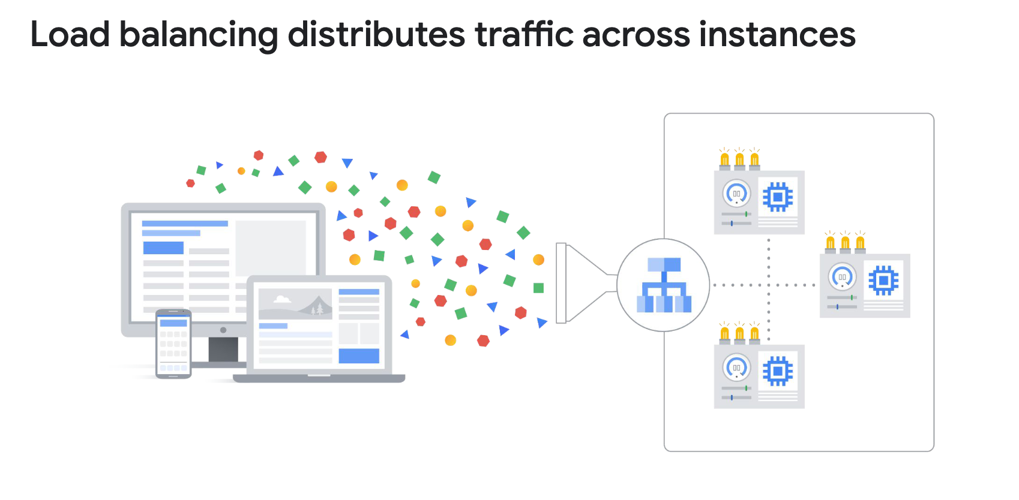
Load balancer
Notes:
This diagram illustrates how a Load Balancer sits in front of your application instances. Incoming requests arrive at the Load Balancer, which then distributes them across multiple backend instances based on health checks and load. Notice how the Load Balancer can route traffic across different zones and regions, providing both horizontal scaling and geographic redundancy. This architecture is the foundation of any highly available application in the Cloud.

Slide 67
quiz
Google Cloud VPCs, what scope do subnets have?
  A: Zonal
  B: Regional
    VPC subnets can span the zones that make up a region. This is beneficial because your solutions can incorporate fault tolerance without complicating your network topology.
  C: Global
  D: Multi-regional
What is the main reason customers choose Preemptible VMs?
  A: To improve performance.
  B: To reduce cost.
    That's correct! The per-hour price of preemptible and spot VMs incorporates a substantial discount.
  C: To use custom machine types
  D: To reduce cost on premium operating systems.
Notes:
Two more quick quizzes before we continue. First: What scope do GCP VPC subnets have — Zonal, Regional, Global, or Multi-Regional? The answer is B — Regional. VPC subnets are regional, which means they can span all zones within a region. This is actually a major advantage — it allows you to build fault-tolerant architectures without needing to manage complex multi-subnet configurations. Second: What is the main reason customers choose Preemptible VMs? The answer is B — to reduce cost. Preemptible and Spot VMs offer a substantial discount — up to 80% cheaper than regular VMs — in exchange for the fact that Google can reclaim them at any time. They're ideal for batch processing jobs and fault-tolerant workloads that can handle interruptions.

Slide 68
Google cloud storage
Object storage is a data storage architecture that manages data as "objects" with metadata and a unique global identifier.
Google Cloud Storage offers fully managed and scalable object storage suitable for various use cases such as data storage for archiving, web content delivery, and distribution of large objects.
Files are organized into "buckets" with unique names and specific geographic locations to minimize latency.
Although it is not a file system, Cloud Storage can be used as one through third-party tools that allow the bucket to be "mounted" as a directory on Linux or MacOS.
Notes:
Now let's explore Google Cloud's storage options. Cloud Storage is GCP's object storage service — it's designed for storing unstructured data as "objects." Each object has content, metadata describing it, and a globally unique identifier. Files are organized into Buckets, which you name and assign to a specific geographic location to minimize latency for your users. Cloud Storage is ideal for a wide range of use cases: storing backups and archives, delivering web content like images and videos, and distributing large datasets or machine learning model files. While it's not a traditional file system, you can mount a Cloud Storage bucket as a directory using third-party tools like GCSFuse.

Slide 69
Google cloud storage
Cloud Storage offers four main storage classes, and stored data is managed and billed based on the "class" to which they belong.
The first class is Standard Storage, ideal for frequently accessed or "hot" data, as well as data stored for short periods.
The second class is Nearline Storage, intended for infrequently accessed data, such as data backups, long-term multimedia content, or data archiving.
The third class is Coldline Storage, similar to Nearline Storage but designed for even less frequent data access or modifications, at most once every 90 days.
The fourth class is Archive Storage, the least expensive, suitable for data archiving, online backups, and disaster recovery, but with higher access and operation costs and a minimum storage duration of 365 days.
Notes:
Cloud Storage offers four storage classes, each optimized for different access patterns and price points. Standard Storage is for frequently accessed — or "hot" — data that you read and write often. Nearline Storage is designed for data you access roughly once a month — think monthly backups or media archives. Coldline Storage is for data accessed at most once per quarter — perhaps older project archives. And Archive Storage is the cheapest option, intended for long-term cold storage like compliance archives or disaster recovery data — but it has higher access costs and a minimum storage duration of 365 days. The key principle: the less frequently you access the data, the cheaper the storage but the more expensive the retrieval. You should choose your storage class based on your actual access patterns to optimize costs.

Slide 70
Google cloud sql
Cloud SQL offers fully managed relational databases (MySQL, PostgreSQL, SQL Server) as a service, freeing users from tedious maintenance tasks such as updates and backups.
No software installation or maintenance is required, providing an easy-to-deploy solution.
Scalability capabilities include up to 64 processor cores, over 400 GB of RAM, and 64 TB of storage.
Automatic replication support and managed backups ensure data availability.
Security is enhanced with data encryption and built-in network firewall.
Compute Engine instances can access Cloud SQL instances, facilitating integration into complex environments.
Compatible with various external tools and applications, providing increased flexibility of use.
Notes:
Cloud SQL is GCP's fully managed relational database service, supporting MySQL, PostgreSQL, and SQL Server. "Fully managed" means Google handles all the operational overhead: patches, updates, backups, and replication — so you can focus on your application, not your database. Cloud SQL is highly scalable — up to 64 CPU cores, over 400 GB of RAM, and 64 TB of storage. It supports automatic replication and managed backups to ensure data availability and durability. Data is encrypted both in transit and at rest, and there's a built-in network firewall. Cloud SQL integrates seamlessly with Compute Engine instances and external applications through standard database connectors, making it compatible with virtually any tech stack.

Slide 71
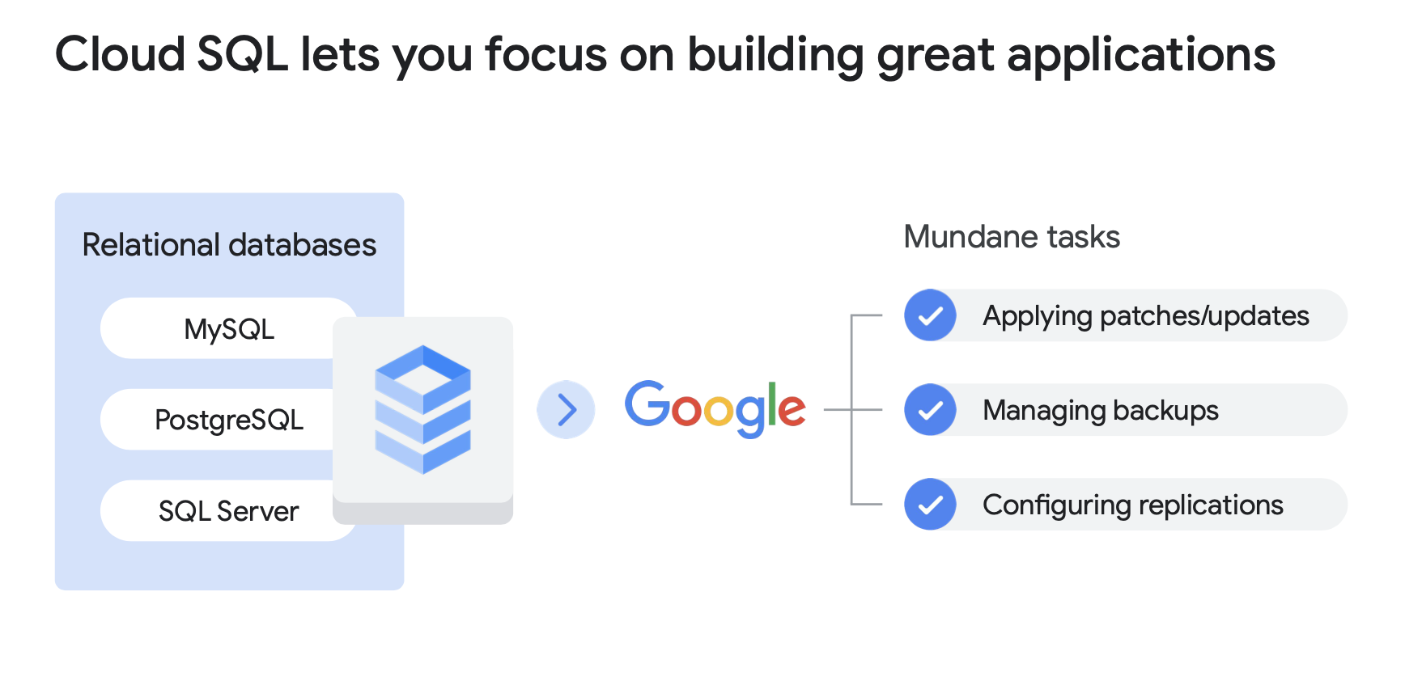
Google cloud sql
Notes:
This diagram illustrates the Cloud SQL architecture — showing how a Cloud SQL instance provides a managed, highly available relational database that can be accessed by Compute Engine VMs, GKE clusters, App Engine applications, and external clients through secure, encrypted connections. The read replicas shown here are key to achieving high read throughput and geographic distribution of your database workload.

Slide 72
Google cloud spanner
Cloud Spanner is a fully managed, horizontally scalable relational database service that supports SQL language and provides strong consistency.
Proven in Google's critical applications and services, Spanner powers Google's $80 billion business.
Cloud Spanner is particularly suitable for applications that require:
  A SQL relational database management system with joins and secondary indexes.
  Built-in high availability.
  Strong global consistency.
  A large number of input/output operations per second, ranging up to tens of thousands of reads/writes per second or more.
Notes:
Cloud Spanner takes managed relational databases to the next level. It's a globally distributed, horizontally scalable relational database that supports full SQL with strong consistency guarantees — something that was previously thought impossible in distributed systems. Cloud Spanner literally powers Google's own $80 billion business, including the backend infrastructure for Google Ads. It's designed for applications that need: full SQL support with joins and secondary indexes; built-in global high availability with no planned downtime; strong consistency across all writes, even across continents; and the ability to handle tens of thousands of read and write operations per second. The trade-off compared to Cloud SQL? Spanner is significantly more expensive — it's designed for mission-critical, globally distributed applications where traditional SQL databases simply can't scale.

Slide 73
Google cloud firestore
Firestore is a flexible and scalable cloud NoSQL database for mobile, web, and server development.
Data is organized into documents within collections, allowing efficient queries with filters and sorting options.
Firestore ensures data synchronization across all connected devices, even offline, through data caching.
It leverages Google Cloud's robust infrastructure, providing automatic data replication, strong consistency, and transactional operations.
Billing is based on document reads, writes, deletes, and storage, with a limited number of free operations per day.
It offers a cost-effective or potentially free starting point for developers with daily free quotas.
Notes:
Firestore is GCP's managed NoSQL document database, designed for mobile, web, and server applications. Data is organized in a flexible document model — documents grouped into collections — which is much more flexible than rigid relational tables. Firestore's killer feature is real-time synchronization: any connected client — whether a web browser or a mobile app — receives data updates in real time as they happen. It even works offline — data is cached locally, and changes are synchronized when the connection is restored. Built on Google Cloud's infrastructure, Firestore provides automatic multi-region replication, strong consistency, and full transactional support. Billing is based on the number of document reads, writes, and deletes, plus storage — and it offers a generous free tier that many developers can start with at no cost.

Slide 74
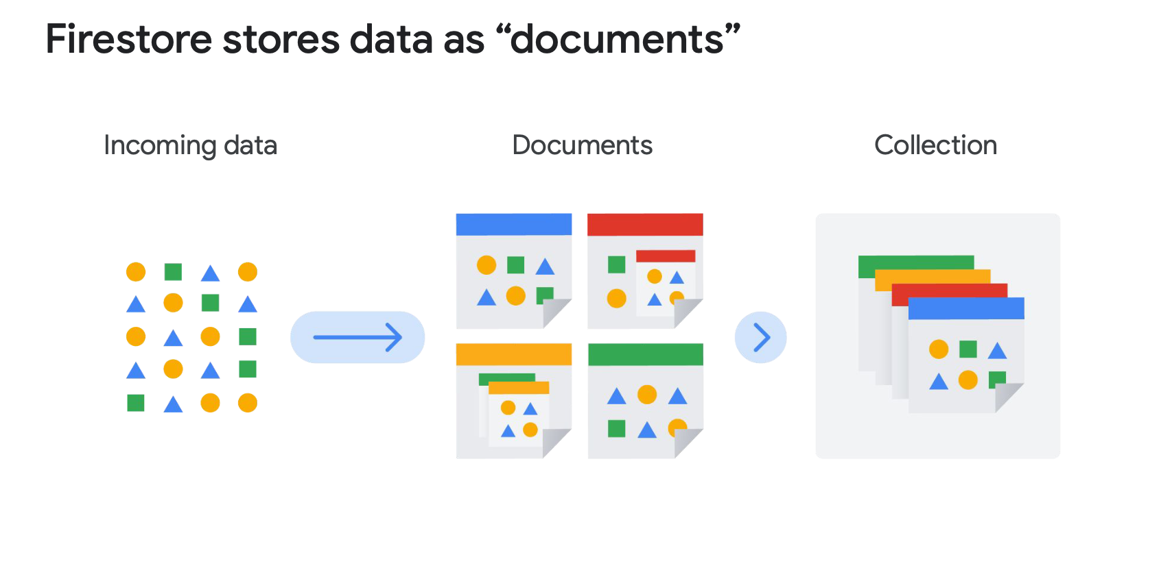
Google cloud firestore
Notes:
This diagram shows a typical Firestore use case: a mobile or web application communicating directly with Firestore through the real-time listener SDK. Notice the offline support — the app continues to function and write data even without internet connectivity, and Firestore synchronizes the data once the connection is restored. This makes Firestore particularly powerful for mobile applications that need to work in unreliable network conditions.

Slide 75
Google cloud bigtable
Cloud Bigtable is Google's NoSQL database service, used by key services such as Search, Analytics, and Gmail.
It offers high performance with low latency, suitable for massive workloads and operational and analytical applications.
Clients choose Bigtable for large data volumes, high throughput, NoSQL data, time-ordered data, or batch and real-time processing.
Bigtable is compatible with other Google Cloud services and third-party clients via APIs, allowing reading and writing data across various layers of stream or batch processing frameworks.
It is used to serve data to applications, dashboards, and data services, as well as for performing calculations and analyses on streaming or batch data.
Notes:
Cloud Bigtable is Google's NoSQL wide-column database service — the same technology that powers some of Google's largest internal services: Search, Analytics, and Gmail. If you need to store and process massive amounts of data at extremely low latency, Bigtable is your tool. It's designed for: very large data volumes — think petabytes; high throughput workloads — millions of read and write operations per second; time-series data — like IoT sensor data or financial market data; and both batch and real-time stream processing. Bigtable integrates with other GCP services and popular big data frameworks like Apache Beam, Spark, and Hadoop. It's typically used to feed dashboards, analytical APIs, and data pipelines that require sub-millisecond response times at massive scale.

Slide 76
Google cloud storage options comparaison
Cloud Storage: Storage for immutable objects over 10 MB, up to 5 TB per object, suitable for images or movies.
Cloud SQL / Cloud Spanner: Full SQL support, Cloud SQL up to 64 TB, Cloud Spanner for horizontal scalability.
Firestore: Massive scalability, real-time query results, terabytes of storage capacity, ideal for mobile and web data.
Cloud Bigtable: Storage for a large number of structured objects, petabytes of capacity, recommended for analytical data with many read and write events.
Notes:
Let's compare all the GCP storage options side by side to understand when to use each one. Cloud Storage: best for large binary objects over 10 MB — images, videos, backups. Up to 5 TB per object. Cloud SQL and Cloud Spanner: for traditional relational data requiring full SQL support. Cloud SQL handles up to 64 TB; Spanner is for global horizontal scalability. Firestore: ideal for mobile and web applications needing real-time sync, flexible document data, and terabytes of storage. Cloud Bigtable: for extremely large volumes of structured data — petabytes — with a high frequency of reads and writes, especially time-series or analytical workloads. The key question to ask yourself when choosing: Is my data relational or non-relational? How large will it get? How frequently will it be accessed? Do I need real-time sync or global distribution?

Slide 77
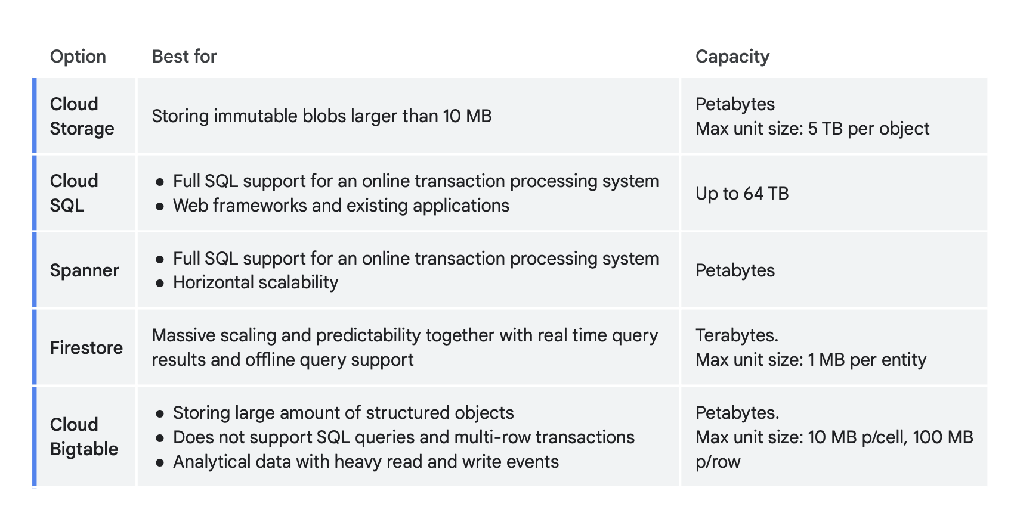
Google cloud storage options comparaison
Notes:
This comparison table gives you a visual summary of all GCP storage options with their key attributes. Use this as a quick reference when you need to decide which storage service to use for a given use case. Pay attention to the "best for" column — it summarizes the sweet spot for each service.

Slide 78
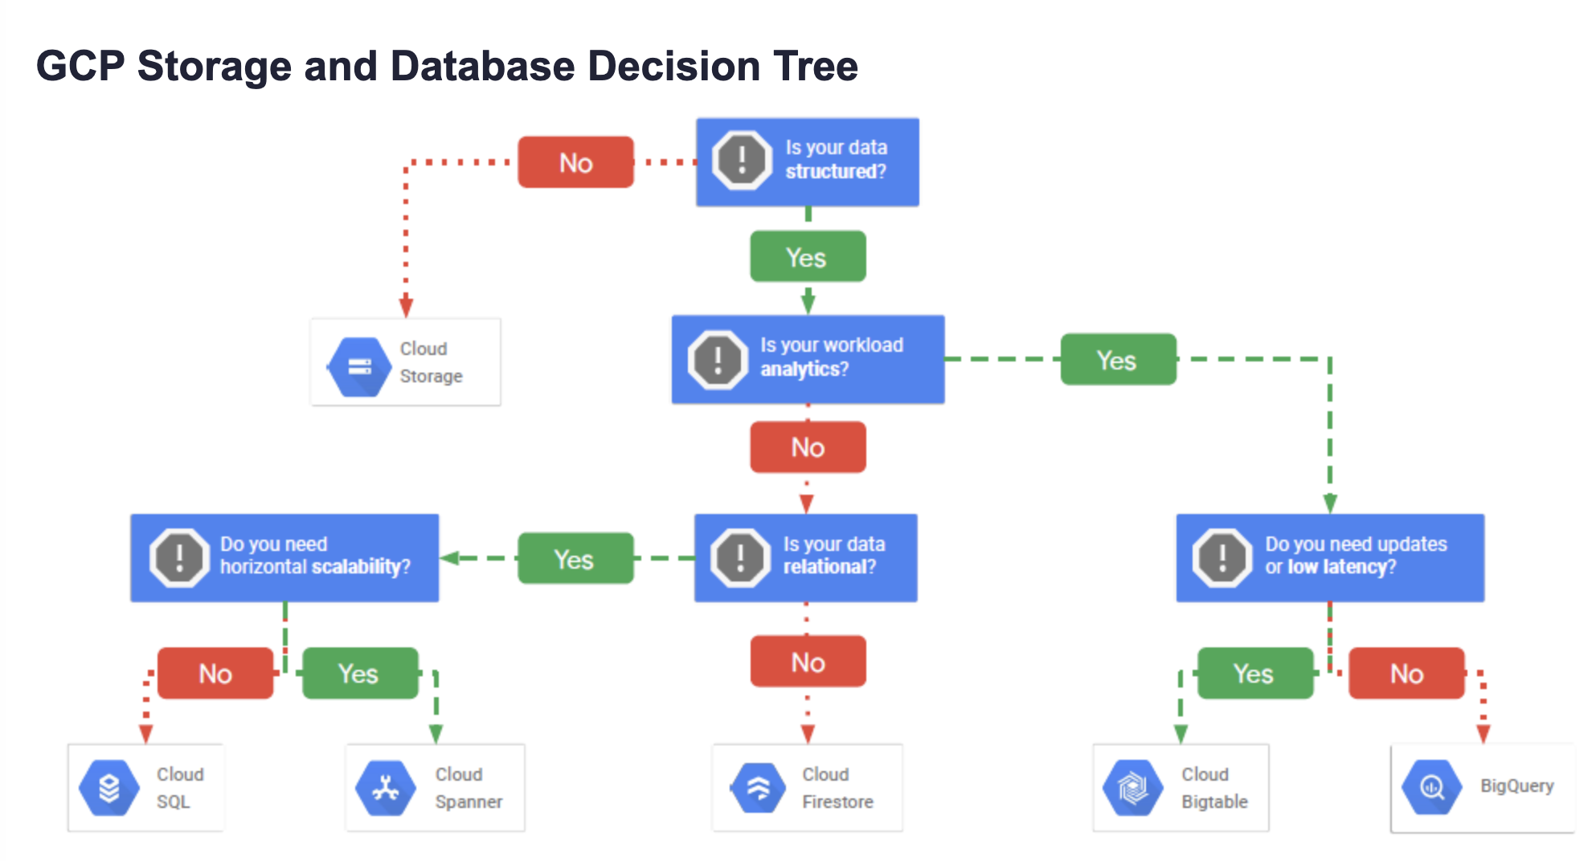
Google cloud storage options comparaison
Notes:
This decision tree diagram helps you navigate the storage choice process. Start with your data type and access patterns, and follow the branches to the recommended storage solution. Having a visual framework like this is very helpful during architecture design and during technical interviews.

Slide 79
Google cloud storage options quiz
What is the correct use case for Cloud Storage?
  A:Cloud Storage is well suited to providing the root file system of a Linux virtual machine.
  B: Cloud Storage is well suited to providing durable and highly available object storage
  C: Cloud Storage is well suited to providing data warehousing services
  D:Cloud Storage is well suited to providing RDBMS services.
Which SQL database service can scale to higher database sizes?
  A: Cloud Spanner.
  B: Cloud SQL.
  C: Cloud Bigtable
  D: Firestore
Notes:
Let's test your knowledge on storage. Question 1: What is the correct use case for Cloud Storage? The answer is B — Cloud Storage is well suited to providing durable and highly available object storage. Not a file system, not a data warehouse, not a relational database — it's an object store for files, images, backups, and large binary data. Question 2: Which SQL database service can scale to higher database sizes? The answer is A — Cloud Spanner. While Cloud SQL supports up to 64 TB, Cloud Spanner is designed to scale horizontally to virtually unlimited sizes, making it the right choice for very large, globally distributed relational workloads. Note that Cloud Bigtable is also very large but it's NoSQL, not SQL.

Slide 80
Google cloud bigquery
BigQuery is a fully managed, highly scalable data warehouse service provided by Google Cloud Platform.
It enables users to analyze vast amounts of data quickly and cost-effectively, without the need for infrastructure setup or maintenance.
BigQuery operates based on columnar storage and distributed query processing.
Users upload their data into BigQuery tables and then execute SQL queries to analyze them.
The benefits of BigQuery are significant:
  Exceptional performance, allowing queries to be executed on petabytes of data in just seconds.
  Fully managed service, with Google handling infrastructure maintenance, reducing operational burden for users.
  Seamless integration with other GCP services such as DataFlow and Pub/Sub, facilitating the construction of comprehensive data pipelines.
However, there are a few drawbacks:
  BigQuery's pricing is based on query and storage usage, which can lead to unexpected costs if resources are not used efficiently.
  While powerful for data analysis, BigQuery may not be suitable for all use cases, particularly those requiring real-time data updates.
Notes:
BigQuery is GCP's fully managed, serverless data warehouse — one of the most powerful data analysis tools available in the cloud. It allows you to run SQL queries on petabytes of data in seconds. How does it work? You load your data into BigQuery tables, and then you run SQL queries — BigQuery automatically distributes the query processing across thousands of servers in parallel. The benefits are remarkable: exceptional query performance, fully managed infrastructure with no setup or maintenance, and seamless integration with other GCP services like Dataflow, Pub/Sub, and Looker Studio for visualization. The cost model is pay-per-query — you pay based on the amount of data scanned. This means it's important to write efficient queries and use partitioning and clustering to minimize data scanned. BigQuery is the tool of choice for business intelligence, data analytics, and machine learning feature engineering.

Slide 81
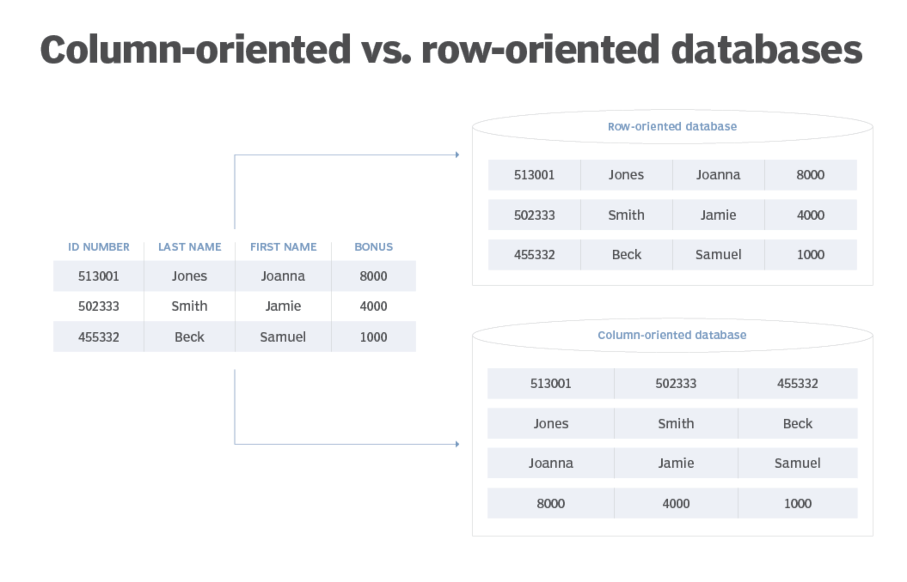
Google cloud bigquery
Notes:
This diagram illustrates the BigQuery architecture. Data is ingested from various sources — streaming via Pub/Sub, batch via Cloud Storage or direct upload — and stored in BigQuery's columnar format. When you run a query, it's executed by a massively parallel distributed processing engine called Dremel. The results are returned to you in seconds, even on petabyte-scale datasets. Notice also the integration with tools like Looker Studio for dashboards and Vertex AI for machine learning — BigQuery sits at the center of GCP's data and AI ecosystem.

Slide 82
containers
Containers are virtual boxes surrounding the code and its dependencies, with limited access to the file system and hardware.
They require minimal resources to be created and start quickly, like a simple process.
Containers offer the flexibility of IaaS (Infrastructure as a Service) with the scalability of PaaS (Platform as a Service), making the code portable and enabling deployments without modification on different platforms.
They allow for "code once, run anywhere" capability, facilitating deployment across different infrastructures.
Containers can be easily scaled to meet demand, enabling rapid and efficient application deployment.
Notes:
We introduced containers earlier in the context of virtualization — now let's revisit them from a deployment perspective. Containers are like a virtual box around your code and its dependencies. They have limited access to the host file system and hardware — only what you explicitly allow. They start in milliseconds and consume very little memory and CPU overhead. Containers give you the flexibility of IaaS — you control what's inside the container — combined with the scalability of PaaS — the cloud platform handles running and scaling your containers. And most importantly, containers are fully portable: you build your container image once, and it runs exactly the same way on your laptop, a test server, a production VM, or a fully managed cloud platform.

Slide 83
kubernetes
Kubernetes is an open-source platform for managing containerized workloads and services.
It allows for the orchestration of numerous containers across multiple hosts, scaling them into microservices, and deploying and rolling back updates.
Kubernetes consists of a set of APIs for deploying containers onto a cluster of nodes.
The nodes in the cluster run the containers, while the control plane manages their deployment and state.
Pods are the basic units in Kubernetes, representing individual processes or entire applications.
Kubernetes enables specifying how applications should interact and manages shared resources among containers.
Kubernetes clusters can be created and managed using Google Kubernetes Engine via the Cloud console or gcloud commands.
Notes:
Kubernetes — already introduced in the virtualization section — is now our primary tool for managing containers in production. It's an open-source platform for automating the deployment, scaling, and management of containerized applications. With Kubernetes, you can run hundreds of containers across dozens of hosts, and Kubernetes handles all the orchestration: scheduling containers onto nodes, scaling them up or down, routing traffic, and restarting failed containers automatically. Clusters are made up of a Control Plane — which manages the cluster state — and worker Nodes — where containers actually run. Pods are the smallest deployable unit in Kubernetes — a pod wraps one or more containers that share storage and network. On GCP, you can create and manage Kubernetes clusters easily using Google Kubernetes Engine through the Cloud Console or gcloud commands.

Slide 84
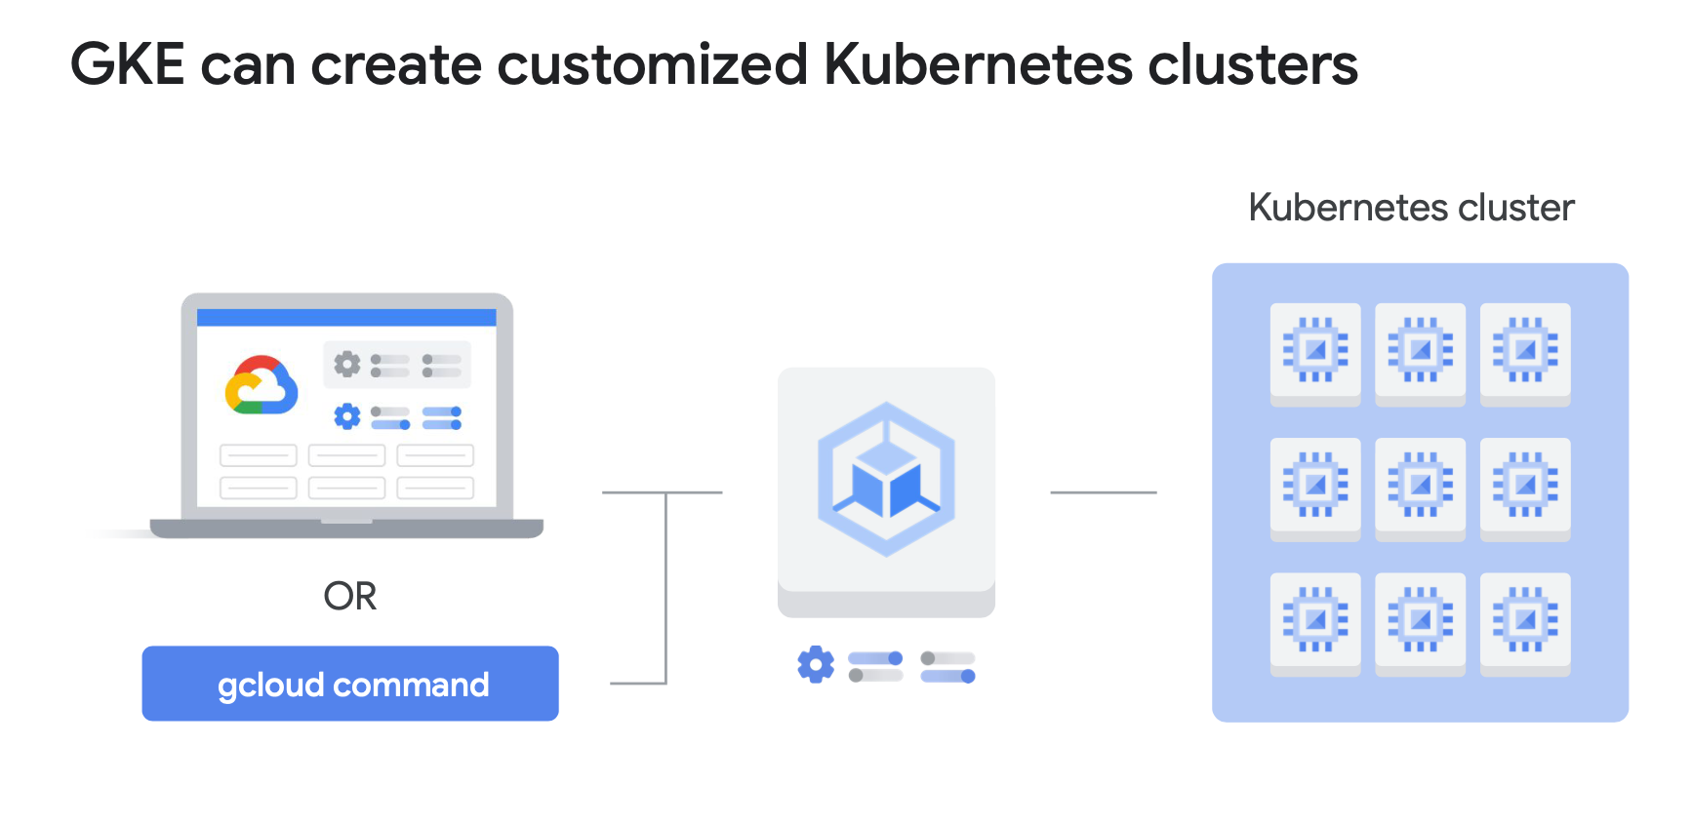
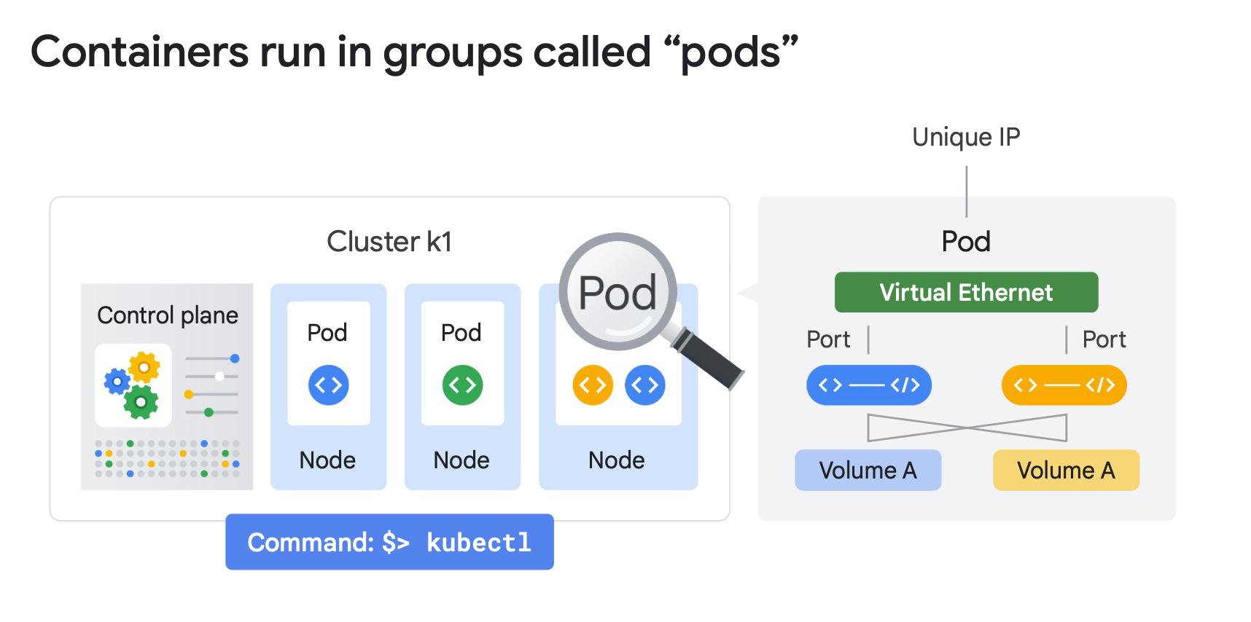
kubernetes
Notes:
This diagram shows a Kubernetes cluster in action. Notice the Control Plane at the top managing the worker nodes. Each worker node runs multiple pods — each pod containing one or more containers. The Kubernetes service routes external traffic to the appropriate pods. When a pod fails, Kubernetes detects it through health checks and automatically reschedules it on a healthy node. This self-healing capability is one of the most powerful features of Kubernetes.

Slide 85
GOOGLE CLOUD RUN
Cloud Run is a managed platform for running stateless containers via web requests or Pub/Sub events.
It is Serverless, eliminating infrastructure management tasks and allowing developers to focus solely on application development.
Cloud Run scales rapidly, adjusting resources based on demand and billing only for actual usage.
The developer workflow involves writing the application, packaging it into a container image, and deploying it to Artifact Registry for deployment on Cloud Run.
Images must be stored in Artifact Registry for deployment.
Developers can deploy code from local sources or existing images in Artifact Registry.
After deployment, Cloud Run provides a unique HTTPS URL to access the application.
It dynamically manages containers to efficiently handle incoming requests.
The Serverless nature of Cloud Run allows developers to focus on coding without the need for infrastructure maintenance.
Notes:
Cloud Run is GCP's fully managed serverless container platform. It builds on all the advantages of containers — portability, isolation, reproducibility — but removes all the infrastructure management burden. It's completely Serverless: you don't manage servers, clusters, or nodes. Cloud Run automatically scales your containers up in response to incoming requests — and scales down to zero when there's no traffic, meaning you pay nothing when your app isn't being used. The workflow is simple: write your application, package it into a container image, push it to Artifact Registry, and deploy it to Cloud Run with a single command. Cloud Run provides a unique HTTPS URL for your application and handles all the routing, load balancing, and certificate management automatically. It's perfect for web APIs, machine learning inference endpoints, and background processing services.

Slide 86
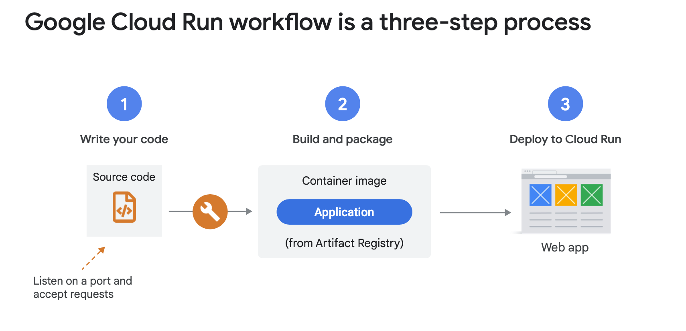
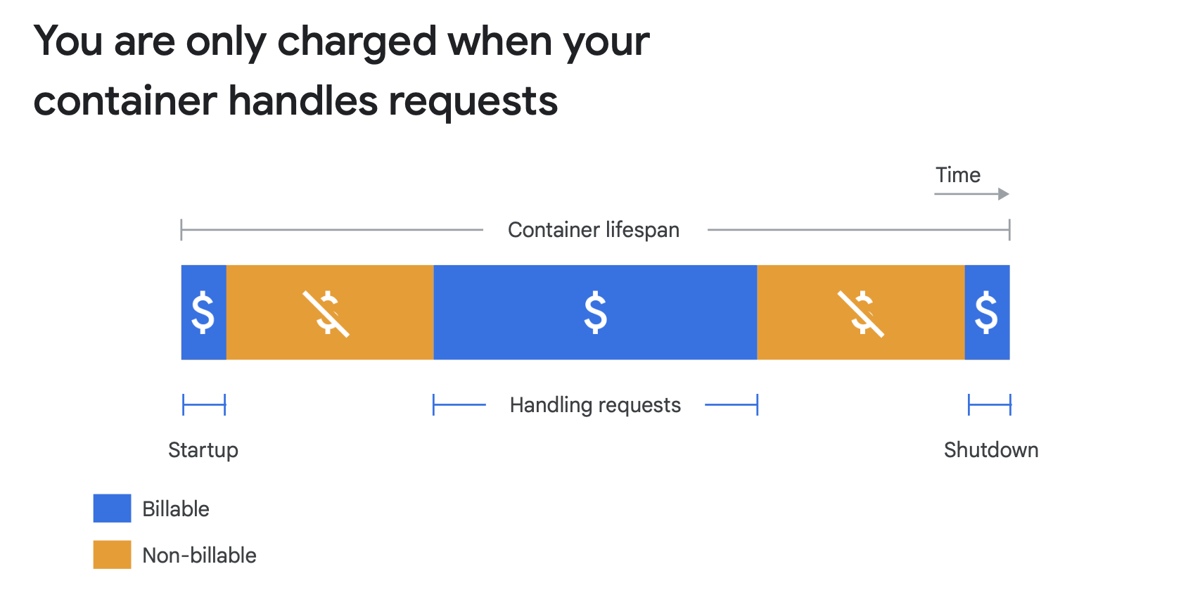
GOOGLE CLOUD RUN
Notes:
This diagram illustrates the Cloud Run request lifecycle. A request comes in via HTTPS to your Cloud Run service URL. Cloud Run routes it to a running container instance — or starts a new one in milliseconds if there's no warm instance available. The container processes the request and returns the response. If traffic increases, Cloud Run automatically spins up more container instances in parallel. When traffic drops, instances are terminated. This elastic scaling model means Cloud Run always has just the right amount of capacity for your current traffic — no more, no less.

Slide 87
GOOGLE CLOUD RUN quiz
Cloud Run can only pull images from:
  A: Docker Hub
  B: Self-hosted registries
  C: Artifact Registry
  D: GitHub
Notes:
Quick quiz on Cloud Run. The question is: Cloud Run can only pull images from which registry? The options are Docker Hub, self-hosted registries, Artifact Registry, or GitHub. The correct answer is C — Artifact Registry. Cloud Run only deploys container images stored in Google Cloud's Artifact Registry. This is an important point to remember: before deploying to Cloud Run, you must first push your Docker image to Artifact Registry. This ensures the images are within GCP's secure environment and benefits from private, low-latency access between services.

Slide 88
CLOUD FUNCTIONS
Cloud Functions allows for creating simple and specific functions that automatically execute in response to cloud events, such as the uploading of a new image, the deposit of a file in Google Cloud Storage, etc.
It is a lightweight, event-based, and asynchronous computing solution that does not require server management or runtime environment.
These functions can be used to build applications from small business logics and to connect and extend cloud services.
Billing occurs at the closest to the millisecond, only during code execution, allowing for economical use of resources.
Cloud Functions supports multiple programming languages, providing flexibility to developers.
Events from Cloud Storage and Pub/Sub can trigger functions asynchronously, while HTTP invocation allows for synchronous execution for direct interactions with the API.
Notes:
Cloud Functions is GCP's serverless Functions-as-a-Service offering. It lets you write small, focused functions that execute automatically in response to cloud events — like a file being uploaded to Cloud Storage, a message arriving on a Pub/Sub topic, or an HTTP request hitting an endpoint. Cloud Functions is completely serverless — no servers, no containers, no infrastructure to manage whatsoever. Functions are event-driven and asynchronous by default. Billing is extremely granular — you pay only for the actual execution time, rounded to the nearest 100 milliseconds. Cloud Functions supports multiple languages: JavaScript via Node.js, Python, Go, Java, and more. A typical use case: every time a new image is uploaded to a Cloud Storage bucket, a Cloud Function automatically runs an ML model on it, extracts metadata, and saves the result to Firestore — all without any manual intervention.

Slide 89
CLOUD FUNCTIONS quiz
What is the advantage of putting the event-driven components of your application into Cloud Functions?
  A: Cloud Functions means that processing always happens free of charge.
    Not free of charge !
  B: Cloud Functions handles scaling these components seamlessly.
    Correct! Your code executes whenever an event triggers it, no matter whether it happens rarely or many times per second. That means you don't have to provision compute resources to handle these operations.
  C: Cloud Functions can be written in C# or C++
    Cloud Functions are written in Javascript (Node.js), Python, or Go.
  D: Cloud Functions eliminates the need to use a separate service to trigger application events.
Notes:
Quiz on Cloud Functions. The question is: what is the advantage of putting event-driven components of your application into Cloud Functions? Option A says processing is always free — that's incorrect, Cloud Functions has a cost per invocation. Option C says functions can be written in C# or C++ — also incorrect, Cloud Functions supports JavaScript, Python, and Go. Option D suggests it eliminates the need for a separate trigger service — also incorrect, you still need triggers like Pub/Sub or HTTP. The correct answer is B: Cloud Functions handles scaling seamlessly. Your code executes whenever an event triggers it, whether that's once a day or a thousand times per second. You don't need to provision or manage any compute resources — Cloud Functions automatically scales to handle any volume of events.

Slide 90
GOOGLE CLOUD DATAFLOW
DataFlow is a real-time and batch data processing solution offered by Google Cloud Platform (GCP). It is based on Apache Beam, a unified programming model for parallel and distributed data processing.
DataFlow operates by allowing developers to define data pipelines using the Apache Beam API. These pipelines describe data processing, whether it involves reading data from a source, transforming it, and writing it to another destination.
There are numerous advantages to DataFlow. Firstly, it offers automatic scalability, efficiently processing massive volumes of data, whether in real-time or batch. Additionally, it integrates well with other GCP services such as Pub/Sub and BigQuery, making it easy to build comprehensive data pipelines. Furthermore, DataFlow is fully managed, meaning Google handles infrastructure maintenance, allowing developers to focus on application development.
However, there are some drawbacks. Pricing can become complex as pipelines become more intricate and data volumes increase. Additionally, although DataFlow is extremely powerful, its learning curve can be steep for new users, especially if they are not familiar with Apache Beam.
Notes:
Google Cloud Dataflow is GCP's fully managed data pipeline service, built on Apache Beam — an open-source unified programming model for both batch and streaming data processing. With Dataflow, you define your data processing logic as a pipeline: read data from a source, apply transformations, and write the results to a destination. Dataflow automatically handles distributing the processing across many workers, scaling up when data volume is high and scaling down when it's not. The key advantages are automatic scalability, deep integration with other GCP services like Pub/Sub and BigQuery, and the fact that it's fully managed — Google handles all the infrastructure. It's ideal for ETL pipelines, real-time event processing, log analysis, and ML feature engineering. The main trade-offs: pricing can get complex at scale, and there's a learning curve for those unfamiliar with Apache Beam's programming model.

Slide 91
GOOGLE CLOUD pub-sub
Pub/Sub, or Publisher/Subscriber, is a fully managed event messaging service offered by Google Cloud Platform. It allows applications to communicate with each other asynchronously, ensuring high scalability and robust reliability.
The operation of Pub/Sub is simple: applications send messages to topics, and then the messages are received by subscribers who are interested in those topics.
There are numerous advantages to Pub/Sub. Firstly, it offers automatic scaling, efficiently processing millions of messages per second. Additionally, it ensures reliable message delivery, even in the event of a system component failure. Pub/Sub also seamlessly integrates with other GCP services, making it easy to build cloud-native applications.
However, there are a few disadvantages to consider. Pub/Sub pricing can increase rapidly with the volume of messages processed, and it can be challenging to predict exact costs.
Notes:
Pub/Sub — short for Publisher/Subscriber — is GCP's fully managed asynchronous messaging service. It decouples the services that produce events from the services that consume them. Here's how it works: publishers send messages to a Topic. Subscribers listen to that topic and receive messages asynchronously. This decoupling is powerful because the publisher doesn't need to know who's listening — it just publishes the event, and any number of subscribers can react to it independently. Pub/Sub can handle millions of messages per second with very low latency. It ensures reliable delivery even if a subscriber is temporarily unavailable. It integrates seamlessly with Cloud Functions, Dataflow, BigQuery, and virtually any other GCP service. Use cases include event-driven architectures, notification systems, data ingestion pipelines, and real-time analytics. The main consideration is cost — it can scale quickly with message volume.

Slide 92
GOOGLE CLOUD dataproc
Cloud Dataproc is a fully managed data processing service based on Apache Hadoop and Apache Spark, offered by Google Cloud Platform (GCP). It allows users to quickly deploy compute clusters in the cloud for analyzing, processing, and transforming large datasets.
The operation of Cloud Dataproc relies on dynamically creating compute clusters, which can be scaled based on data processing needs. Users can run batch processing tasks, interactive analyses, and even streaming workflows.
The advantages of Cloud Dataproc are significant. Firstly, it offers elastic scalability, allowing users to provision and deactivate clusters quickly based on workload. Additionally, Cloud Dataproc is compatible with open-source data processing tools and frameworks such as Apache Spark, Apache Hadoop, and Presto, providing great flexibility to users. Furthermore, Cloud Dataproc seamlessly integrates with other GCP services like BigQuery and Google Cloud Storage, making it easy to build comprehensive data pipelines.
However, there are a few drawbacks. Cloud Dataproc pricing can be complex, as it depends on the type of instance used, the cluster's runtime duration, and other factors. Additionally, while Cloud Dataproc offers great flexibility, cluster management and configuration can be complex for less experienced users.
Notes:
Cloud Dataproc is GCP's fully managed service for running Apache Hadoop and Apache Spark workloads in the cloud. If you have existing big data pipelines built on these frameworks, Dataproc lets you run them on GCP without any replatforming. Dataproc clusters can be created in 90 seconds or less — much faster than spinning up your own Hadoop cluster. You can scale clusters dynamically based on your data processing needs and shut them down when you're done, paying only for what you use. It integrates with Cloud Storage, BigQuery, and other GCP services, making it easy to build end-to-end data pipelines. Use cases include batch ETL processing, large-scale data analysis, and machine learning training jobs using Spark MLlib. The main challenges are pricing complexity — it depends on instance types, runtime, and other factors — and the fact that cluster configuration can be complex for users new to Hadoop and Spark ecosystems.

Slide 93
AI SERVICES ON GCP
Notes:
We've now reached the final major section of this course: AI Services on Google Cloud Platform. GCP is widely recognized as a leader in artificial intelligence and machine learning tooling. Let's explore what's available.

Slide 94
GOOGLE CLOUD vertex-ai
Vertex AI is a fully managed artificial intelligence (AI) platform offered by Google Cloud Platform. It allows developers and data scientists to easily create, deploy, and manage AI models at scale.
The operation of Vertex AI is based on a modular approach, offering tools for every stage of the AI model lifecycle. This includes data preparation, model training, model deployment in production, and monitoring their performance.
There are numerous advantages to Vertex AI. Firstly, it offers a unified experience for AI model development and deployment, reducing complexity and required efforts. Additionally, Vertex AI provides advanced features such as AutoML (automated machine learning) and TensorFlow Enterprise, enabling users to create AI models even without deep expertise in data science. Furthermore, Vertex AI seamlessly integrates with other GCP services, making it easy to build comprehensive AI pipelines.
However, there are a few drawbacks. Vertex AI pricing can become complex, depending on the resources used and the size of deployed models. Additionally, while Vertex AI offers many features, some advanced tasks may require additional expertise in data science or software engineering.
Notes:
Vertex AI is GCP's unified AI and Machine Learning platform. It brings together all the tools you need for the complete ML lifecycle — from data preparation and model training to deployment, monitoring, and management — all in one place. Vertex AI supports two main approaches to building models: AutoML, which allows you to train high-quality models on your data with no code required — just upload your dataset and specify what you want to predict. And Custom Training, which gives data scientists full control to write their own training code using TensorFlow, PyTorch, scikit-learn, or any other framework. Beyond training, Vertex AI offers Model Garden — a catalog of pre-built open-source models you can deploy directly — and Generative AI tools that give you access to Google's large language models. The main considerations are pricing complexity and the fact that some advanced tasks may require significant ML expertise.

Slide 95
GOOGLE CLOUD vertex-ai
Vertex AI is a machine learning (ML) platform that allows you to train and deploy ML models and AI applications, and customize large language models (LLMs) for use in your AI-based applications. Vertex AI combines data engineering, data science, and ML engineering workflows, enabling your teams to collaborate using a common set of tools and scale your applications by leveraging the benefits of Google Cloud.
Vertex AI offers several options for model training and deployment:
  AutoML allows you to train tabular, image, text, and video data without writing code or preparing data splits. Just choose your dataset and the target variable to predict.
  Custom training gives you full control over the training process, including using your preferred ML framework, writing your own training code, and choosing hyperparameter tuning options.
  Model garden enables you to discover, test, customize, and deploy models in Vertex AI, and select from Open Source Software (OSS) models and components.
  Generative AI allows you to access large generative AI models from Google (and others) for multiple modalities (text, code, images, voice). You can fine-tune Google's LLMs to meet your needs, and then deploy them for use in your AI-based applications.
Additionally, predictive models can be created in BigQuery using BQML. These models can be used in Vertex AI.
Notes:
Let's go deeper into Vertex AI's training options. AutoML allows you to train models on tabular, image, text, and video data without writing a single line of code. You simply select your dataset and the target variable you want to predict — Vertex AI handles feature engineering, model selection, and hyperparameter tuning automatically. Custom Training gives you full flexibility — you write your own training code, choose your ML framework, and control every aspect of the training process. Model Garden lets you browse, test, and deploy open-source models from Google and the broader ML community — from classic ML models to large language models. And Generative AI gives you direct access to Google's foundation models — Gemini, PaLM, Imagen, and more — for text, code, images, and voice. You can also use BigQuery ML — BQML — to build predictive models directly in BigQuery using SQL, and then deploy those models through Vertex AI.

Slide 96
GOOGLE CLOUD vertex-ai
Once your models are deployed, use Vertex AI's end-to-end MLOps tools to automate and scale projects throughout the ML lifecycle. These MLOps tools run on fully managed infrastructure that you can customize based on your performance and budget needs.
You can use the Vertex AI Python SDK to run the entire machine learning workflow in Vertex AI Workbench, a development environment based on a Jupyter notebook. You can collaborate with a team to develop your model in Colab Enterprise, a version of Colaboratory integrated with Vertex AI. Other available interfaces include the Google Cloud console, the gcloud command-line tool, client libraries, and Terraform (limited compatibility).
Vertex AI also offers the ability to label data in your datasets.
Pre-trained models are available via API: Google Vision API, Google Speech API, etc., with a cost per call.
Notes:
Once your model is trained, Vertex AI provides everything you need to deploy and monitor it. You can use the Vertex AI Python SDK to build, train, and deploy models entirely from a Jupyter notebook in Vertex AI Workbench. For team collaboration, Colab Enterprise — a version of Google Colab integrated with Vertex AI — allows multiple data scientists to work together on the same notebooks with access to powerful GPU-backed compute. Vertex AI also supports labeling data in your datasets — useful when you need to annotate training data at scale. And for teams that don't want to build custom models, Google provides pre-trained models accessible via API: the Vision API for image analysis, the Speech API for audio transcription, the Natural Language API for text understanding, and more. Each API call has a cost, but it's a very fast way to add AI capabilities to your application without any ML expertise.

Slide 97
GOOGLE CLOUD vertex-ai mlops
Once your models are deployed, they need to track changes in the environment to optimize their performance and remain relevant. MLOps is a set of practices that improves the stability and reliability of your ML systems.
Orchestrating workflows: Manually training and deploying your models can be time-consuming and error-prone, especially if you need to repeat processes multiple times. Vertex AI Pipelines allow you to automate, monitor, and manage your ML workflows.
Tracking metadata used in your ML system: In data science, it's important to track the parameters, artifacts, and metrics used in your ML workflow, especially when you're repeating the workflow multiple times. Vertex ML Metadata allows you to query this metadata to analyze, debug, and audit the performance of your ML system or the artifacts it produces.
Identifying the best model for a use case: When trying new algorithms, you need to know which trained model performs best. Vertex AI tests allow you to track and analyze different model architectures, hyperparameters, and training environments to identify the best model for your use case.
Vertex AI TensorBoard allows you to track, visualize, and compare ML experiments to measure the performance of your models.
Notes:
MLOps — Machine Learning Operations — is the practice of applying DevOps principles to the machine learning lifecycle. Once your model is deployed in production, you need to track changes in the data environment, monitor model performance over time, and update your models when they start to degrade. Vertex AI provides a full suite of MLOps tools. Vertex AI Pipelines let you automate your entire ML workflow — from data ingestion through training to deployment — as a repeatable, monitored pipeline. Vertex ML Metadata tracks all the parameters, datasets, and metrics used in your experiments, making it easy to reproduce results and audit your models. Vertex AI Experiments allow you to compare different model architectures and hyperparameters to find the best-performing model for your use case. And Vertex AI TensorBoard provides interactive visualizations of your training metrics, letting you monitor and compare experiments in real time.

Slide 98
GOOGLE CLOUD vertex-ai mlops
Managing model versions:
  Adding models to a central repository allows you to track model versions. Vertex AI Model Registry provides an overview of your models to better organize, track, and train new versions. From Model Registry, you can evaluate and deploy models to an endpoint, create batch predictions, and view information about specific models and model versions.
Managing features:
  When reusing ML features across multiple teams, you need a fast and efficient way to share and distribute them. Vertex AI Feature Store provides a centralized repository for organizing, storing, and publishing ML features. By using a central feature store, your organization can reuse ML features at scale and accelerate the development and deployment of new ML applications.
Monitoring model quality:
  A model deployed in production performs best on prediction input data similar to the training data. When input data deviates from the data used to train the model, model performance can degrade, even if the model itself hasn't changed. Vertex AI Model Monitoring monitors training/inference gaps and prediction drifts, sending alerts when prediction input data is too far from the training reference. You can use alerts and feature distributions to determine if you need to retrain your model.
Notes:
Continuing with MLOps tools in Vertex AI. Model Registry is a central repository for all your model versions — it gives you a clear overview of what's deployed, what's in development, and the performance history of each version. From the registry, you can deploy models to endpoints, create batch predictions, and manage model versions systematically. Feature Store is a centralized repository for ML features — the input variables used by your models. By storing features centrally, multiple teams can reuse the same features across different models, ensuring consistency and accelerating development. Model Monitoring is critical for production ML systems. When the distribution of real-world input data shifts away from the training data — a phenomenon called data drift or concept drift — model performance degrades over time. Vertex AI Model Monitoring continuously tracks these shifts and sends alerts when the input data deviates too far from the training distribution, helping you decide when it's time to retrain your model.

Slide 99
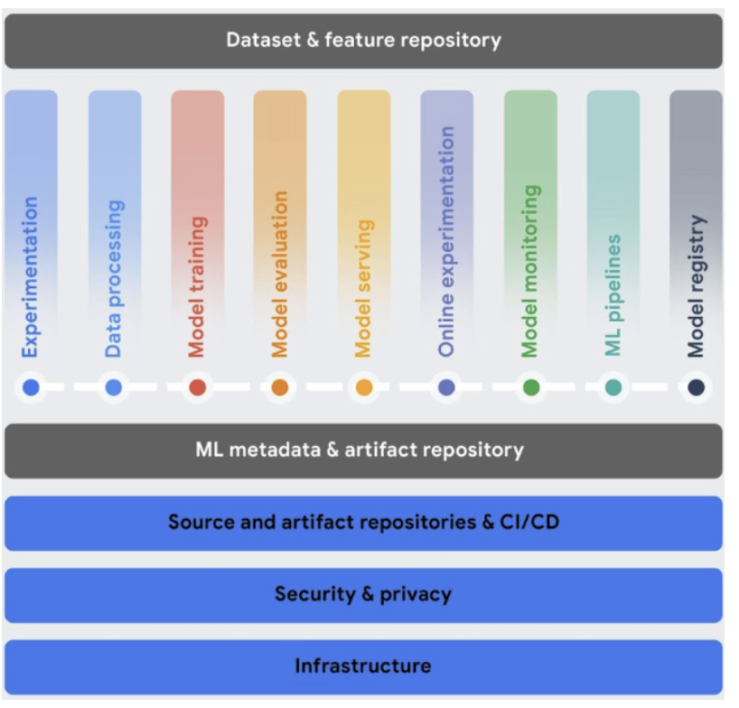
GOOGLE CLOUD vertex-ai mlops
Notes:
This diagram provides a complete visual overview of the Vertex AI MLOps workflow — from data ingestion and preparation on the left, through model training and evaluation in the center, to deployment, monitoring, and continuous improvement on the right. Notice how all the stages are connected in a feedback loop — model monitoring feeds back into new training runs, creating a continuous cycle of improvement. This end-to-end ML lifecycle management is what separates production-grade ML systems from notebook experiments.

Slide 100
GOOGLE CLOUD vertex-ai gen ai
Generative AI on Vertex AI gives you access to large generative AI models from Google so you can test, customize, and deploy them for use in your AI-enhanced applications.
Here is a description of the generative AI workflow:
  The Prompt: The generative AI workflow typically starts with a prompt. A prompt is a natural language request sent to a language model to trigger a response. Writing a prompt to get the desired response from the model is a practice called prompt engineering. Although designing a prompt is an experimental process, you can use principles and prompt design strategies to prompt the model to behave as desired.
  Base Models: Prompts are sent to a model for response generation. Vertex AI has various foundational generative AI models accessible via an API, including the following:
    Gemini API: Advanced reasoning, multi-turn chat, code generation, and multimodal prompts.
    PaLM API: Natural language tasks, continuous vector representations of text, and multi-turn chat.
    Codey API: Code generation, code completion, and code chat.
    Imagen API: Image generation, image editing, and image description.
    MedLM: Medical question-answering and synthesis system. (Private Beta)
  The size, modality, and costs of models vary. You can explore Google's proprietary models and OSS models in the Model Garden.
Notes:
Let's look at Generative AI capabilities on Vertex AI. Vertex AI gives you access to Google's most powerful generative AI models so you can build AI-enhanced applications. The workflow starts with a Prompt — a natural language instruction sent to a model. Crafting effective prompts is a skill called Prompt Engineering. The prompt is sent to a Foundation Model. Google's models available on Vertex AI include: the Gemini API for advanced multi-modal reasoning, multi-turn chat, and code generation. The PaLM API for natural language tasks and continuous vector embeddings. The Codey API for code generation, completion, and explanation. The Imagen API for image generation, editing, and captioning. And MedLM, a specialized model for medical question-answering, currently in Private Beta. Each model has different capabilities, sizes, and costs. You can explore all of them — including open-source alternatives — in the Model Garden.

Slide 101
GOOGLE CLOUD vertex-ai gen ai
You can customize the default behavior of Google's base models so they consistently generate desired results without using complex prompts. This customization process is called Fine Tuning. Customizing these models helps reduce the cost and latency of your requests by allowing you to simplify your prompts.
Vertex AI also provides model evaluation tools to help you assess the performance of your fine-tuned model. Once your fine-tuned model is ready for production, you can deploy it to an endpoint and monitor its performance, as in standard MLOps workflows.
If the prompt and response pass security filter checks, the response is returned. Typically, the response is returned all at once. However, you can also receive responses progressively as they are generated by enabling streaming.
Another method for customizing a generative AI is called Retrieval augmented Generation (RAG):
  Can be used to create applications outside of GCP.
  Can be used within the 'Gen App Builder,' which is a GCP application.
Notes:
Beyond using models with simple prompts, Vertex AI allows you to customize Google's foundation models through Fine Tuning. Fine-tuning adjusts the model's weights based on your specific domain data, making it much more accurate for your use case. This also reduces prompt complexity — a shorter, simpler prompt can achieve the same result as a long, complex one on a non-fine-tuned model. After fine-tuning, you deploy the model to an endpoint and monitor it like any other production model. Another powerful customization technique is Retrieval-Augmented Generation — or RAG. RAG doesn't change the model itself, but instead gives it access to external knowledge — like your company's documents, databases, or APIs — at inference time. The model retrieves relevant information and uses it to answer questions accurately. RAG can be implemented outside of GCP or within GCP using the Gen App Builder platform.

Slide 102
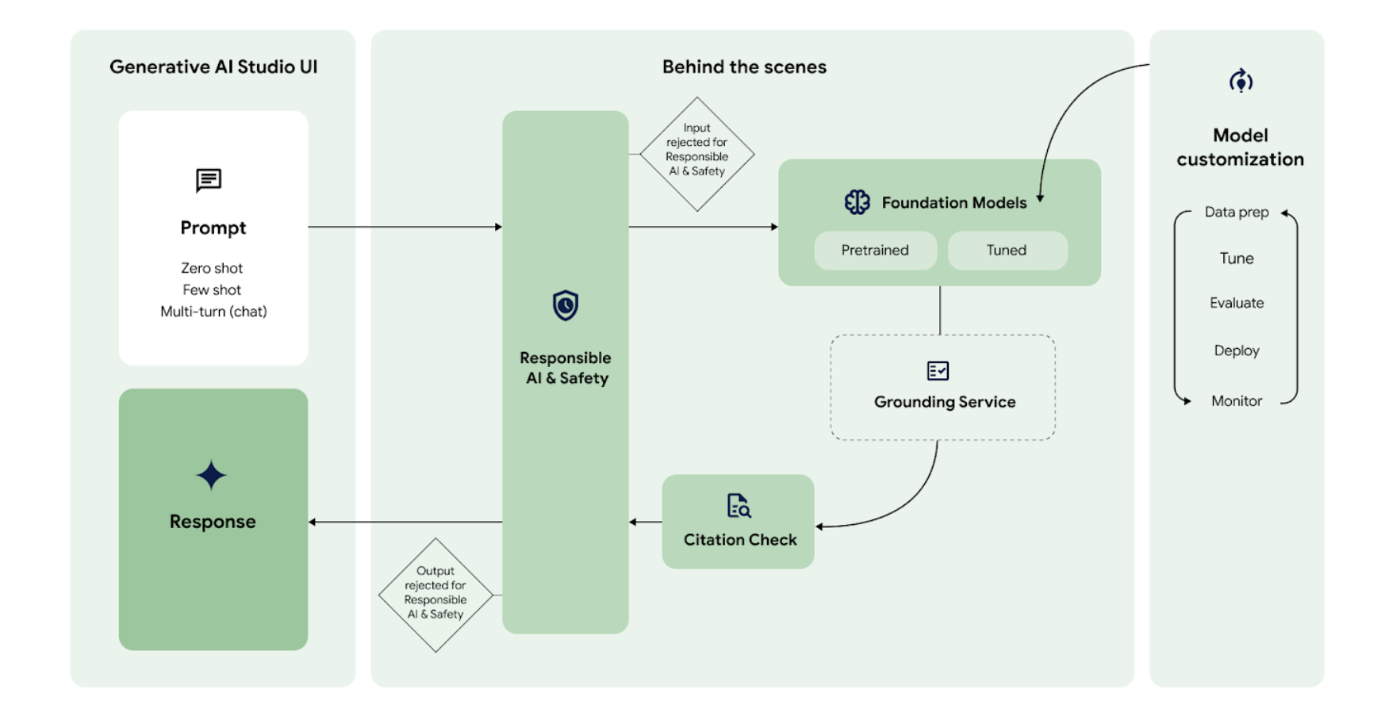
GOOGLE CLOUD vertex-ai gen ai
Notes:
This diagram illustrates the Generative AI development workflow on Vertex AI — from designing your prompt in the Prompt Design interface, to testing models in Model Garden, to deploying a fine-tuned model to an endpoint. Notice the safety filter layer — all inputs and outputs pass through Google's content safety filters before being returned to the user, ensuring responsible and appropriate AI responses.

Slide 103
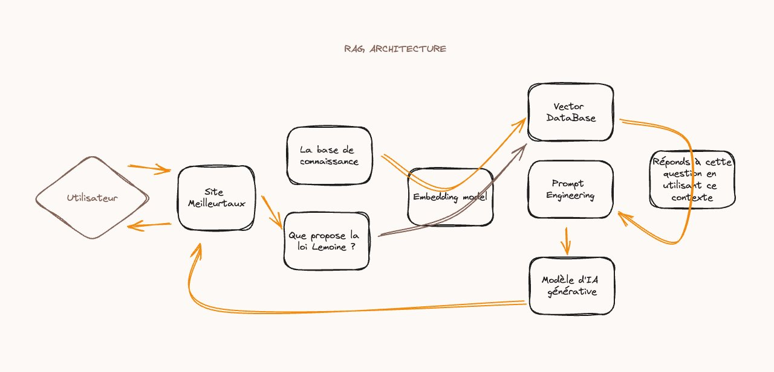
GOOGLE CLOUD vertex-ai gen ai
Notes:
This diagram shows the RAG — Retrieval-Augmented Generation — architecture. When a user asks a question, the system first queries an external knowledge base — like a vector database or document store — to retrieve the most relevant pieces of information. That context is then combined with the original prompt and sent to the language model. The model generates an answer that is grounded in the retrieved documents, significantly reducing hallucinations and making the responses much more accurate and trustworthy for domain-specific applications. This is the architecture behind most enterprise chatbots and AI assistants built on GCP today.

Slide 104
Thank you!
Notes:
And that brings us to the end of this Cloud Computing course! Thank you all for your attention, your questions, and your engagement throughout these sessions. We've covered a lot of ground — from the fundamentals of Information Systems and Cloud Computing, through virtualization and containers, to hands-on deployment on GCP, and finally the most advanced AI and MLOps capabilities. I hope this course has given you a solid foundation that you can apply directly in your internships and future careers. The cloud is evolving rapidly — I encourage you to keep experimenting, keep learning, and take advantage of GCP's free tier to practice what you've learned. Good luck to all of you, and don't hesitate to reach out if you have any questions after the course. Thank you!

